Slide 1
Spatial and Temporal Language Understanding:
Representation, Reasoning, and Grounding
Part II: IE, QA, and Reasoning of “Time”
Parisa Kordjamshidi, Michigan State University, USA, kordjams@msu.edu
Marie-Francine Moens, KU Leuven, Belgium, sien.moens@cs.kuleuven.be
James Pustejovsky, Brandeis University, USA, jamesp@cs.brandeis.edu
Qiang Ning, Amazon, USA, qiangning.01@gmail.com
NAACL
Jun 17, 2024

Slide 2
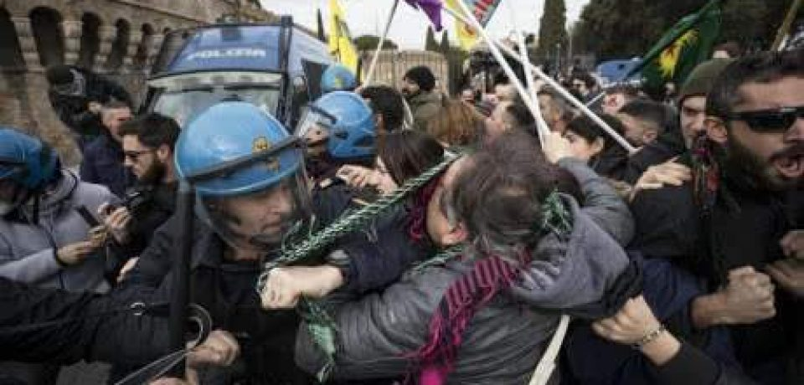
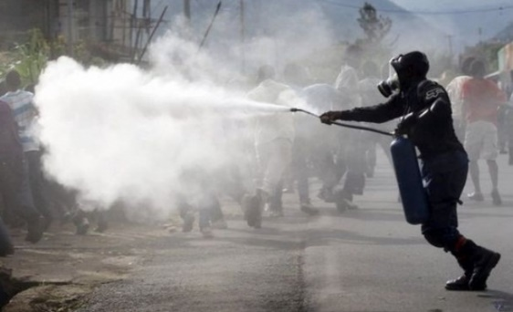


Location is important for understanding events
People were angry
Police used tear gas
There’s often no relationship between these two events if they’re from different places in the world
Pin icon credits to Artdabana@Design from the Noun Project
Notes:
Typically there’s no causal relationship between these two events because they’re from different places in the world

Slide 3
Time is important for understanding events
People were angry
Police used tear gas
Time
People were angry first (likely causing chaos), and then the police used tear gas (to restore order).
Notes:
Time is important for story understanding. For instance, let's look at two events: people were angry and police used tear gas. If this is the temporal ordering, people got angry first and followed by tear gas. It leaves us with the impression that people may have turned anger into violence. And that's why tear gas was used.
(22'')

Slide 4
Same events, different temporal ordering
Police used tear gas
People were angry
Time
Police used tear gas (during a conflict), and then people were angry (because of the action police took).
Notes:
However, if we reverse the temporal ordering, then we get a different story, where people were angry at the police because they had used tear gas inappropriately.
(12'')

Slide 5
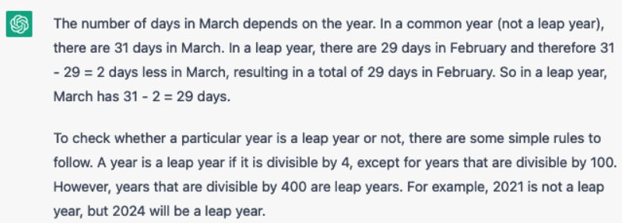

Examples where “time” plays an important role
How many days are there in March?
GPT-3.5; accessed in Mar 2023
GPT-4o; accessed in Jun 2024
Notes:
Here's another information seeking example asking about the number of days in March.

Slide 6
Examples where “time” plays an important role
[June, 1989] Chris Robin lives in England and he is the person that you read about in Winnie the Pooh. As a boy, Chris lived in Cotchfield Farm. When he was three, his father wrote a poem about him. His father later wrote Winnie the Pooh in 1925.
  Where did Chris Robin live?
Notes:
“The only thing constant is change.” – Heraclitus
The world is evolving over time: one’s place of work, place of home, a conflict between two countries, the progress of a social event, …
Let’s look at an example.

Slide 7
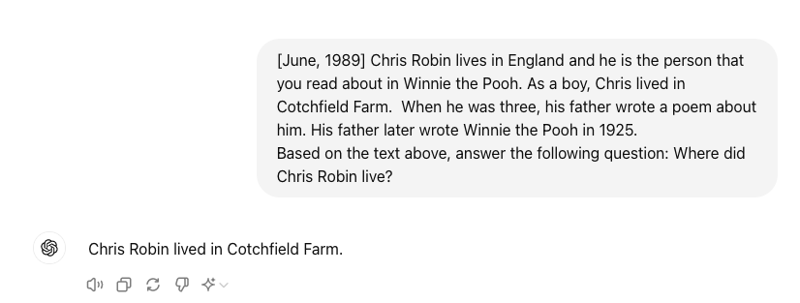
Examples where “time” plays an important role
[June, 1989] Chris Robin lives in England and he is the person that you read about in Winnie the Pooh. As a boy, Chris lived in Cotchfield Farm. When he was three, his father wrote a poem about him. His father later wrote Winnie the Pooh in 1925.
  Where did Chris Robin live?
    This is time sensitive: He lives in England (at least at the time of 1989); as a boy, he lived in Cotchfield Farm.
GPT-4o; accessed in Jun 2024
Notes:
“The only thing constant is change.” – Heraclitus
The world is evolving over time: one’s place of work, place of home, a conflict between two countries, the progress of a social event, …
Many applications rely on a good understanding of time.

Slide 8
Examples where “time” plays an important role
[June, 1989] Chris Robin lives in England and he is the person that you read about in Winnie the Pooh. As a boy, Chris lived in Cotchfield Farm. When he was three, his father wrote a poem about him. His father later wrote Winnie the Pooh in 1925.
  When was Chris Robin born?
Notes:
“The only thing constant is change.” – Heraclitus
The world is evolving over time: one’s place of work, place of home, a conflict between two countries, the progress of a social event, …
Many applications rely on a good understanding of time.

Slide 9
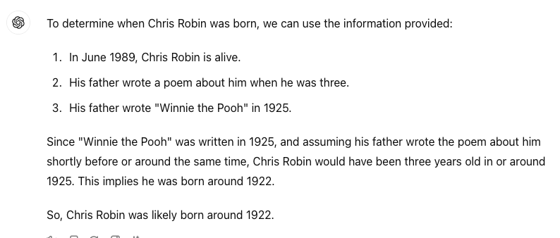
Examples where “time” plays an important role
[June, 1989] Chris Robin lives in England and he is the person that you read about in Winnie the Pooh. As a boy, Chris lived in Cotchfield Farm. When he was three, his father wrote a poem about him. His father later wrote Winnie the Pooh in 1925.
  When was Chris Robin born?
    This requires reasoning: Chris Robin was at least 3 years old in 1925, so he was likely born before 1922.
GPT-4o; accessed in Jun 2024
This information is not needed.
Notes:
“The only thing constant is change.” – Heraclitus
The world is evolving over time: one’s place of work, place of home, a conflict between two countries, the progress of a social event, …
Many applications rely on a good understanding of time.

Slide 10
“Time” in real text
The bridge collapsed during the storm but after traffic was rerouted to the Bay Bridge.
President Roosevelt died in April 1945 before
  the war ended. (event happened)
  he dropped the bomb. (event didn’t happen)
The CEO plans to retire next month.
Last week Bill was running the marathon when he twisted his ankle. Someone had tripped him. He fell and didn't finish the race.
Slides credits to James Pustejovsky’s 2011 talk on TimeML

Slide 11
“Time” is a broad concept
Many types of NLP tasks require certain level of understanding of time.
Examples that the community have focused on:
  Time expression understanding: “end of the year” = ?
  Relation extraction: “Event_A” →before→“Event_B”
  QA: What happened after Roosevelt died?
  Knowledge graphs: (Barack Hussein Obama, President of, USA, [2009, 2017])
  …
Time expressions
Temporal relations
QA
QA
QA
knowledge graphs
QA
knowledge graphs

Slide 12
A structured view of the NLP literature about “time”
 | Information extraction | Question Answering | Reasoning
Intrinsic to “time” (i.e., targeting a better understanding of time) | Time expressions Temporal relations Temporal grounding | Temporal order QA | Temporal relation graph inference Temporal logic
Extrinsic to “time” (i.e., solving tasks that require consideration of time) | Timeline summarization Temporal knowledge graphs Causality | Situated QA Time-sensitive QA Temporal QA over knowledge graphs | Robotic control
Time expressions
Temporal relations
QA
QA
knowledge graphs
QA
QA
knowledge graphs
Purpose is to help understand content in this talk
Not the only way to view the literature
Not exhaustive

Slide 13
Scope of the talk
 | Information extraction | Question Answering | Reasoning
Intrinsic to “time” (i.e., targeting a better understanding of time) | Time expressions Temporal relations Temporal grounding | Temporal order QA | Temporal relation graph inference Temporal logic
Extrinsic to “time” (i.e., solving tasks that require consideration of time) | Timeline summarization Temporal knowledge graphs Causality | Situated QA Time-sensitive QA Temporal QA over knowledge graphs | Robotic control Trip planning

Slide 14
Main papers to cover in this talk
 | Information extraction | Question Answering | Reasoning
Intrinsic to “time” (i.e., targeting a better understanding of time) | SteQE^{[1]} | TORQUE^{[2]} | NL2TL^{[3]}
Extrinsic to “time” (i.e., solving tasks that require consideration of time) | Timeline summarization Temporal knowledge graphs Causality | Situated QA Time-sensitive QA Temporal QA over knowledge graphs | AutoTEMP^{[4]}
[1] A Meta-framework for Spatiotemporal Quantity Extraction from Text. Ning et al., ACL’22.
[2] TORQUE: A Reading Comprehension Dataset of Temporal Ordering Questions. Ning et al., EMNLP’20.
[3] NL2TL: Transforming Natural Languages to Temporal Logics using Large Language Models. Chen et al., EMNLP’23.
[4] AutoTAMP: Autoregressive task and motion planning with LLMs as translators and checkers. Chen et al., ICRA’24.

Slide 15
Start with annotation schemes of “time”
Two key concepts for annotating “time” are
  Event mentions (E)
  Time points (T)
We can view the existing annotation schemes of “time” based on how they deal with E and T
  Focus on (E,T) relationship
  Focus on (E,E) relationship
  Both (E,T) and (E,E) relationships

Slide 16
TimeML
ISO-TimeML: An international standard for
temporal annotation
  TLINKs
    (E,T): “Link events to the document time and to local time expressions”
    (E,E): “Order event relative to other events”
  I’ll give a talk on 6/16.
Event
Time
Event-Event (E,E) relations form a graph
ripping
monitor
In Los Angeles that lesson was brought home Friday when tons of earth cascaded down a hillside, ripping two houses from their foundations. No one was hurt, but firefighters ordered the evacuation of nearby homes and said they'll monitor the shifting ground until March 23rd.
hurt
cascaded
ordered
BEFORE
BE_INCLUDED

Slide 17
TimeML
ISO-TimeML: An international standard for
temporal annotation
  TLINKs
    (E,T): “Link events to the document time and to local time expressions”
    (E,E): “Order event relative to other events”
  TimeBank^{[1][2]}
    The classic dataset using TimeML
    A major driving force for advancement in the last two decades
[1] TimeBank: https://catalog.ldc.upenn.edu/LDC2006T08
[2] TempEval-3: Evaluating Events, Time Expressions, and Temporal Relations. UzZaman et al., SemEval 2013.

Slide 18
Focusing on (E,T) relationship -- EventTime 2016^{[1]}
“Annotation complexity”: Quadratic vs linear
  If there’re N events, there’re O(N²) pairs of (E,E) relations, but there’re only O(N) time points to consider for (E,T) relations.
  Advantage: the time of an event doesn’t have to come from the text verbatim.
He was sent into space on May 26, 1980. He spent six days aboard the Salyut 6 spacecraft.
Annotations:
Sent: 1980-05-26
Spent: [1980-05-26, 1980-06-01] (this time interval is not from the text verbatim)
[1] Temporal Anchoring of Events for the TimeBank Corpus. Reimers et al., ACL’16.

Slide 19
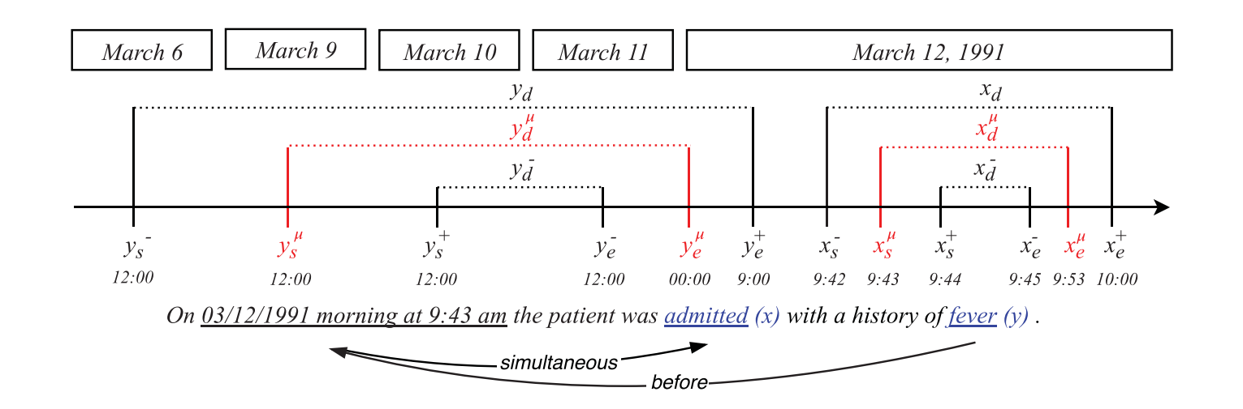
Focusing on (E,T) relationship -- AbsoluteTimeline 2022^{[1]}
Used time boundaries to represent (reasonable) guesses when text comes with uncertainty. E.g., “a history of fever” is assumed to be in the several days before March 12, 1991, not weeks or months.
[1] Towards extracting absolute timelines from English clinical reports. Leeuwenberg & Moens, IEEE/ACM Transactions on Audio, Speech, and Language Processing 2022.

Slide 20
SteQE 2022: when COVID happened
A Meta-framework for Spatiotemporal Quantity Extraction from Text. Ning et al., ACL’22.
Notes:
When COVID first appeared in the US, there were a great number of news articles covering various aspects of the pandemic. It was desired to have a dedicated tool that can extract and synthesize information from all of them, in all places, in all time points. This is important for, either better understanding the situation for policy makers, or for many applications built on top of this database.

Slide 21
SteQE: Spatiotemporal Quantity Extraction
This paper proposes a meta-framework for studying spatiotemporal phenomena of quantity events.
  Quantity events: numbers associated with events
  Spatiotemporal: when and where did this event happen?
  Meta-framework: problem formulation, re-usable data annotation pipeline, and baseline models
SteQE: We release data from three sociopolitical events: the COVID-19 pandemic, Black Lives Matter (BLM) protests, and 2020 California wildfires.
Original talk in 2022: https://www.youtube.com/watch?v=rNl2Jcu0NgA

Slide 22
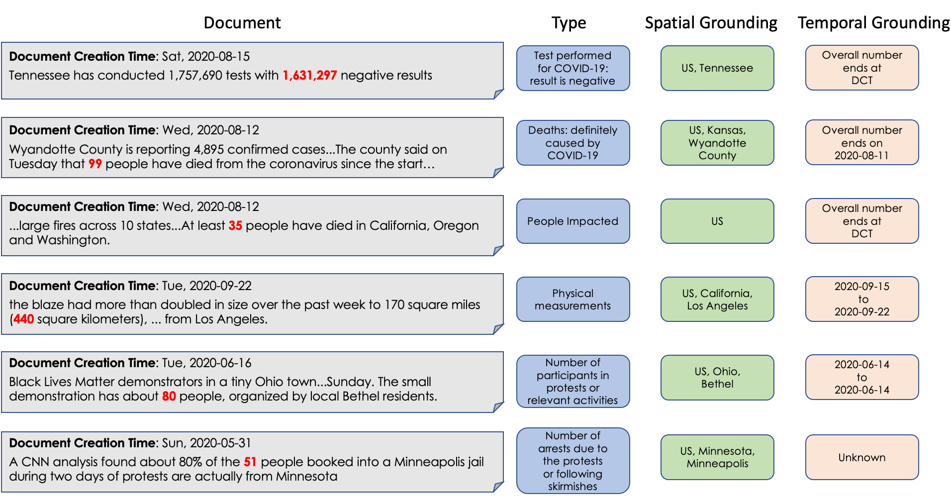
Data Preview
Notes:
This is what our data looks like. We're not going to read everything. Please pause your video and double check the examples, and we'll simply skip it here.

Slide 23
SteQE: Task Formulation
Monday, Sep 14 2020
Title: Change in western US weather to bring wildfire and smoke relief for some, high fire danger for others
…Over 4.6 million acres of land are actively burning across the West , with most of these blazes ongoing in California, Washington and Oregon, according to the National Interagency Fire Center. Many of these blazes exploded in size during a high wind event around the Labor Day holiday. At least 35 people have been killed along the West coast as a result of the blazes, and tens of thousands have been forced to evacuate, according to The Associated Press…
[DCT] [Title t₁, t₂, t₃, …] [Body Text b₁, b₂, …,q₁, q₂,…, q_{m}, … b_{n}]
Predict
tokens
Type
Location
Time span
Notes:
given an article, time, and its title, we arrange these in the following format, and the SteQE task is decomposed into 4 subtasks: ....

Slide 24
SteQE: Task Formulation
1. Quantity Recognition
  Similar to named entity recognition (NER), quantity recognition is defined as a text span detection problem.
    A BERT model was shown to be very reliable system extracting quantities, so we took BERT predictions as gold.
[DCT] [Title t₁, t₂, t₃, …] [Body Text b₁, b₂, …,q₁, q₂,…, q_{m}, … b_{n}]
Predict
tokens
Type
Location
Time span

Slide 25
SteQE: Task Formulation
2. Quantity Typing
  Predefined label set (e.g., positive cases & hospitalization)
  A clear event type is important for subsequent spatiotemporal grounding, but some quantities have multiple types.
    Single-typing: “[three] men were hospitalized 5 days after being tested positive”
    We enforce single-typing by providing an order of importance. For instance, hospitalization is more important than tested positive, so the spatiotemporal extent of “three” will be that of hospitalizations.
Notes:
We can consider the time span of 20% as the exact date when the infection rate became 20% or the entire span, or as the entire span when infection rate was zero all the way up to 20%. We've identified a couple of types to exclude in this work, but an obvious alternative is to make a choice and teach annotators to disambiguate in this case.

Slide 26
SteQE: Task Formulation
3. Spatial Grounding
  To ground real-world events to a real-world locale
  Format
    choose from a predefined set of questions to determine the country (U.S. vs non-U.S.) and state,
    use free text for the name of the city
    use span selection for more granular locale information (e.g., a pork plant)
  Granularity
    the most specific location mentioned in the text that contains all individual cases of a quantity event

Slide 27
SteQE: Task Formulation
4. Temporal Grounding
  To ground each real-world quantity event to a single time span
  Format
    A time span consists of two time points, and the key is the format for time points.
    Select calendar dates from our UI (e.g., Feb 1st, 2021)
    When a time point is unclear based on the text, we allow annotators to simply select “Unknown”

Slide 28
SteQE: Task Formulation
4. Temporal Grounding
  Overall quantity: We identified a special type of quantity – overall quantity – that needs special attention in practice
  “There have been [3 million] COVID-19 positive cases so far”. The start time is the beginning of the pandemic, but people do not always agree on when that was because:
    the pandemic started at different times in different regions
    one may argue that the pandemic started either since the first confirmed case, or since the lockdown.
  We allow “overall” as a label for the start time of a quantity.
Notes:
This debate over start-time is not an NLP problem, so instead of inventing a new mechanism to resolve this, we simply allow ``overall'' as a label for the start time of a quantity.

Slide 29
SteQE: Task Formulation
4. Temporal Grounding
  Granularity
    Given the nature of news events, it is often enough to be specific up to “day”
    The best over-estimate of the gold time span based on text
First event
Last event
- case
Time
Gold time span
Best over-estimate based on text

Slide 30
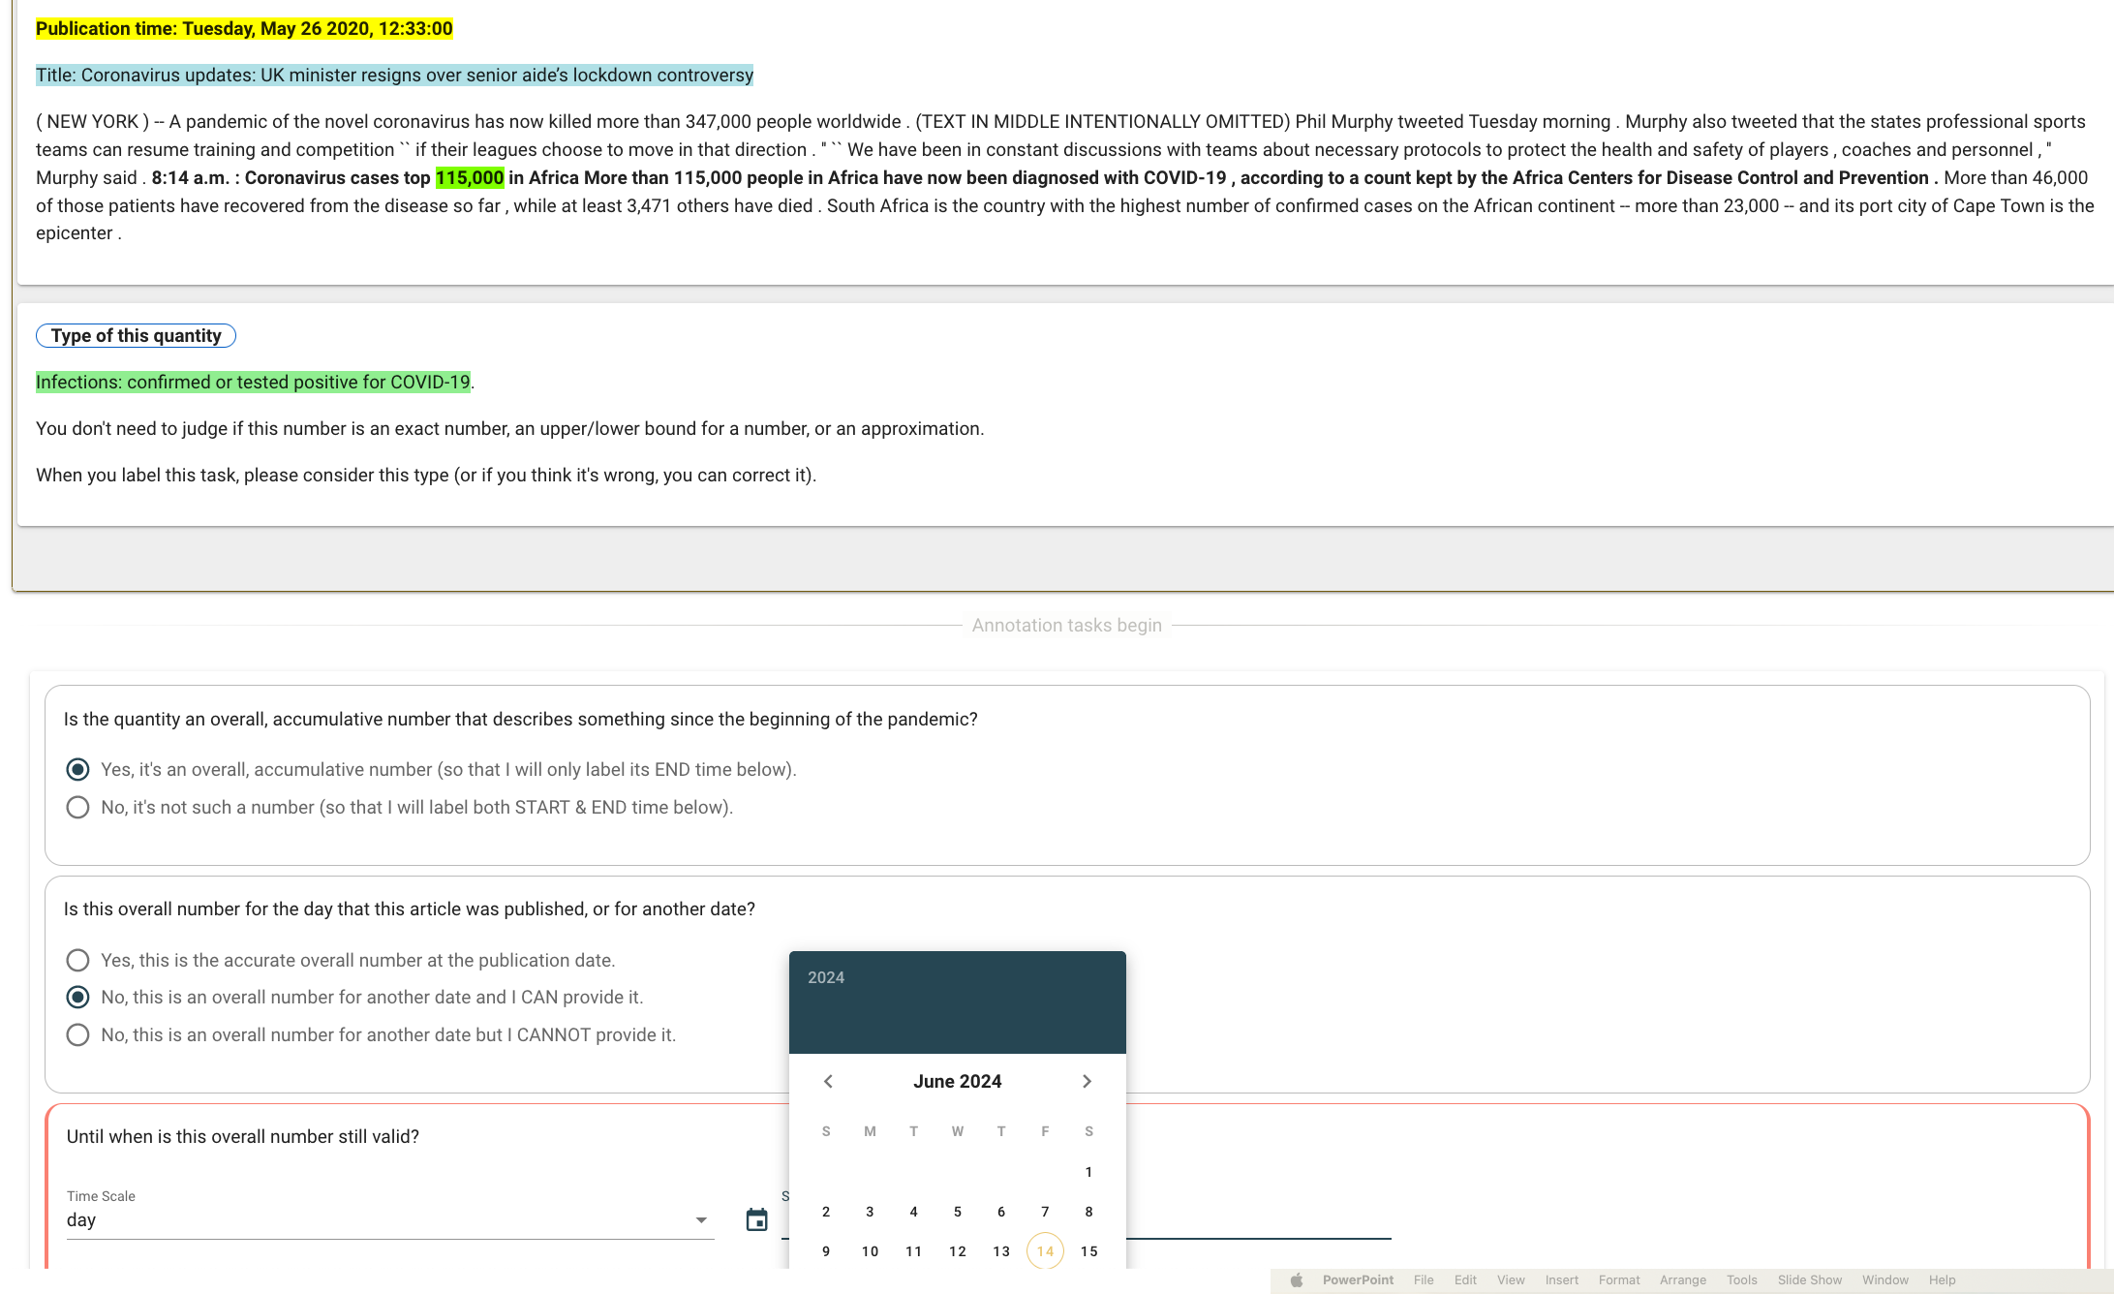
Annotation UI on Crowdaq
Check these links:
Quantity typing: UI
Spatial grounding: UI
Temporal grounding: UI

Slide 31
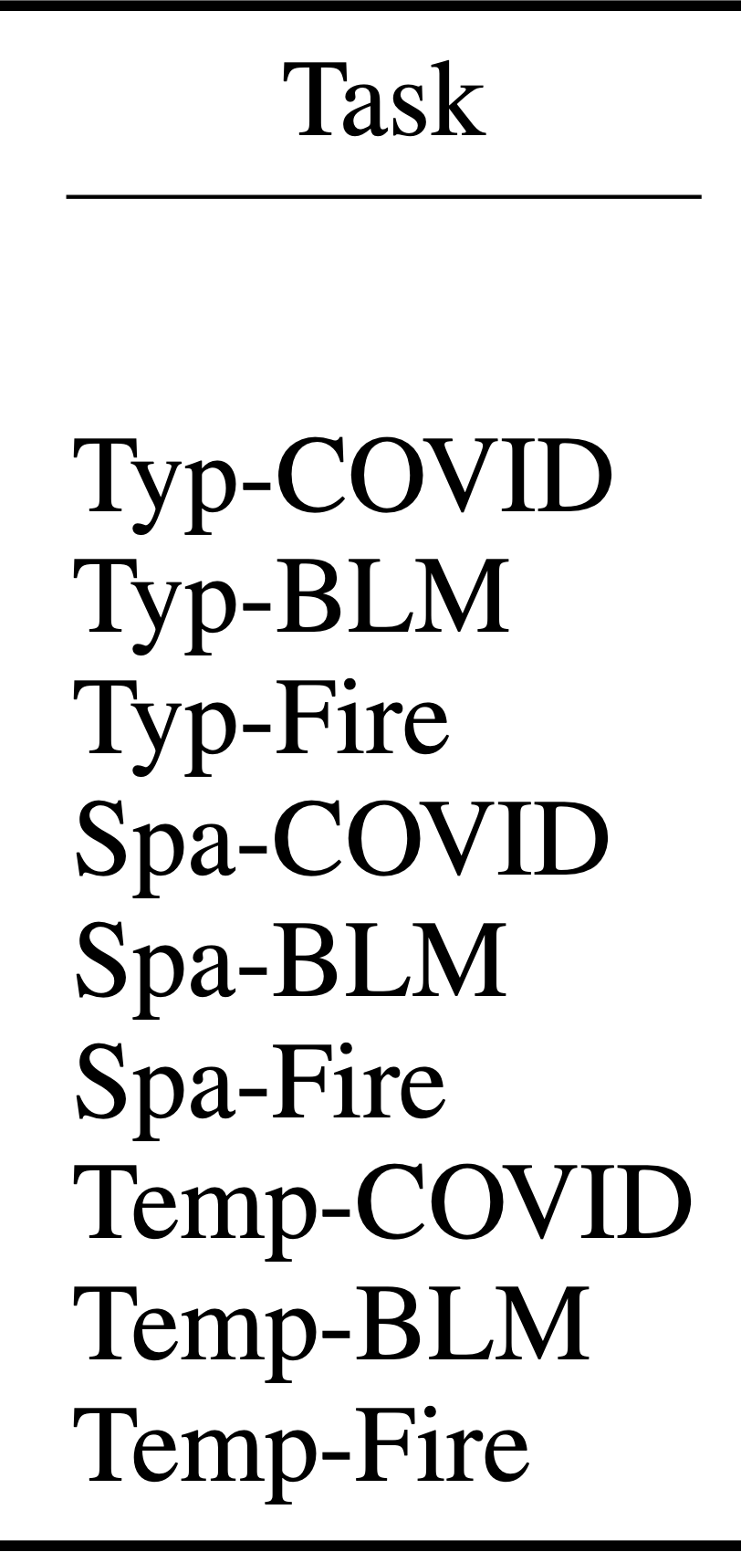
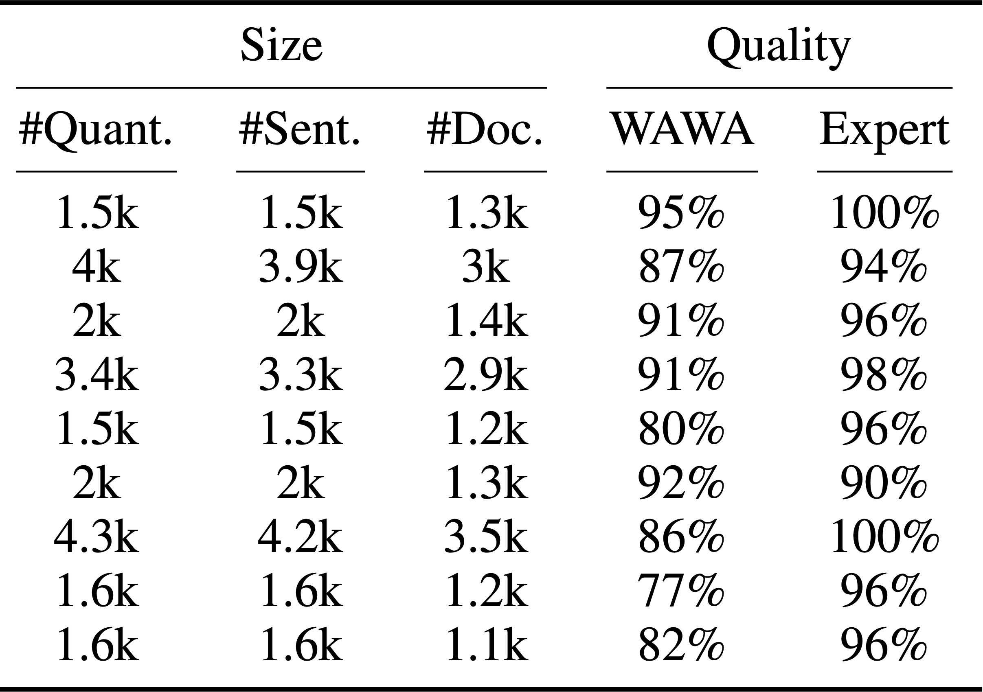
Data Statistics

Slide 32
Modeling
Quantity Recognition
  Token classification with BERT (ignored in this talk)
Typing and Spatiotemporal Grounding
  Format labels as token sequences
  Learnt with T5-large
T5 input
T5 gold output*
Typing Model
… over the past week to <MARKER> 170 square miles …
Physical measurements
Spatial Model
… over the past week to <MARKER> 170 square miles …
US, California, Log Angeles
… over the past week to <MARKER> 170 square miles …
2020-09-15
2020-09-22
Temporal Model
Notes:
We propose models that fulfill individual components as detailed in the problem formulation, which includes quantity recognition, typing, spatial grounding, and temporal grounding. Quantity recognition is done with BERT under a token classification setting. We omit its implementation detail in this talk. Typing, spatial and temporal grounding are done with T5-large using its generative sequence-to-sequence training objective. We use input documents as T5’s input and format the labels in individual tasks into a sequence of tokens as the expected generation output. For example, given the document that includes the quantity of 170 square miles, we place a marker token to the left of the quantity span to indicate which quantity the model should focus on. The typing model will be supervised to generate a sequence of the label, which in this case is physical measurements, and the spatial model will be supervised to generate US, California, Los Angeles. We replace some tokens with special T5 vocabularies to avoid confusion.

Slide 33
Experiments
Metrics:
  Spatial: Exact Match (city level)
  Temporal: Non-overall quantities (start/end time exact match)
Datasets: COVID-19, BLM, CalFire
  Test set: Each domain has 500 fully annotated test quantities
Setting:
  Trained only on in-domain data vs on all 3 domains
Model:
  T5-large
Notes:
Naturally, we include three evaluation tasks. For typing, we use accuracy as the metric, for spatial, we use exact match, and evaluate on both city and state level. For time, the first metric we use is a binary accuracy metric, evaluating whether a model can successfully tell if the quantity is an overall number ending on DCT. The second metric evaluates those quantities that are not overall numbers, which are more challenging.
We evaluate both start and end time exact-match in that case. For each domains, we use 500 fully annotated quantities for evaluation.
We compare models that are trained on only in-domain supervision, and those that are trained on all domain’s supervision. We also compare with a set of naive baselines that are designed for each task.

Slide 34
Temporal start time: exact match (EM)
Naïve: always predict the document creation time

Slide 35
Temporal end time: EM
Naïve: choose the time expression closest to the quantity span

Slide 36
Results – Spatial EM (up to city-level)
Naïve: choose the nearest city mention of the quantity span

Slide 37
Temporal Overall (binary)
Naïve: always predict “overall number ending on DCT”

Slide 38
Results - Typing
Naïve: predict the most popular type in each domain
Notes:
Typing is an easy task.

Slide 39
Information Verification
Discrepancy between two sources
  Source 1 (therapidian.org at May 11 2020, 19:43:00): …Statewide , there are 47,552 cases , 4,484 deaths , and 22,686 recoveries confirmed …
  Source 2 (wzzm13.com at May 11 2020, 06:54:00): GRAND RAPIDS , Mich. -- … The total number of cases is 47,552 and 4,584 have died , according to the data from Michigan 's Dept…
NYT data base: 4,584 total death in Michigan on 5/11/2020. Our hypothesis is that Source 1 made a typo.

Slide 40
Information Verification
Discrepancy between two time points (same source)
  Accessed on 4/3/2020: Pennsylvania has 7,016 cases of COVID-19 with 18 in Adams County, and 23 in Franklin County. There are 17,589 cases in Virginia with 121 in Loudoun County. West Virginia has 217 cases of coronavirus, 12 in Jefferson County, and 27 in Berkeley County.
  Accessed again on 5/8/2020: Pennsylvania has 7,016 cases of COVID-19 with 18 in Adams County, and 23 in Franklin County. West Virginia has 217 cases of coronavirus, 12 in Jefferson County, and 27 in Berkeley County.
NYT database: 1,706 cases in Virginia with 121 in Loudoun County. Our hypothesis is that the website found that the red sentence was wrong so they deleted it.

Slide 41
COVID-19 cases
Less mentioning of China and World case numbers
Started mentioning NJ
Less mentioning of New York & US after a sharp increase
Notes:
There’re also some interesting phenomena that we’d like to share. Not necessarily solid; after all we’re not social scientists, but just sharing what we find in our data

Slide 42
Recap: Annotation schemes of “time”
Two key concepts for annotating “time” are
  Event mentions (E)
  Time points (T)
We can view the existing annotation schemes of “time” based on how they deal with E and T
  Focus on (E,T) relationship
  Focus on (E,E) relationship
  Both (E,T) and (E,E) relationships

Slide 43
Recap: Annotation schemes of “time”
Two key concepts for annotating “time” are
  Event mentions (E)
  Time points (T)
We can view the existing annotation schemes of “time” based on how they deal with E and T
  Focus on (E,T) relationship
  Focus on (E,E) relationship
  Both (E,T) and (E,E) relationships

Slide 44
TimeML / TimeBank
Police tried to eliminate the pro-independence army and restore order. At least 51 people were killed in clashes between police and citizens in the troubled region.
Annotation task: to label the TempRels between the bold faced events
TimeBank [Pustejovsky et al., 2003]
  Annotators freely add TempRels between those events.
  It’s likely that some TempRels will be missed.
  E.g., only one relation between “eliminate” and “restore” is annotated in TimeBank, while other relations such as “tried” is before “eliminate” and “tried” is also before “killed” are missed.

Slide 45
TimeBank-Dense^{[1]}
Police tried to eliminate the pro-independence army and restore order. At least 51 people were killed in clashes between police and citizens in the troubled region.
TimeBank-Dense^{[1]}
  “All” – all event pairs are presented, one-by-one, and an annotator must provide a response for each of them.
  “1” – In the physical world, time is one dimensional.
  “0” – missing relations anymore.
  “?” – However, some pairs of events are very confusing, resulting in disagreement.
[1] An annotation framework for dense event ordering. Cassidy et al., ACL’14.

Slide 46
Problem
Police tried to eliminate the pro-independence army and restore order. At least 51 people were killed in clashes between police and citizens in the troubled region.
E.g., what’s the relation between restore and killed?
  restore BEFORE killed?
  restore INCLUDES killed?
  restore AFTER killed?

Slide 47
MATRES: Multi-axis scheme^{[1]}
Police tried to eliminate the pro-independence army and restore order. At least 51 people were killed in clashes between police and citizens in the troubled region.
We suggest that multiple time axes exist in natural language.
Intention axis
restore order
✓
to eliminate army
✓
police tried
51 people killed
Main axis
✓
[1] A Multi-Axis Annotation Scheme for Event Temporal Relations. Ning et al., ACL’18.

Slide 48
MATRES: Multi-axis scheme
We complete a set of definitions for axes
Event Type | Axis Type | %
intention, opinion | orthogonal axis | ~20
hypothesis, generic | parallel axis | ~10
negation | not on any axis
static, recurrent | not considered now
main | main axis | ~70

Slide 49
With a better IAA (>80%)
The performance of a baseline system on our new dataset is much better than one on the old dataset
+22%
+21%
[Old dataset] Cassidy et al. ACL’14. An annotation framework for dense event ordering.

Slide 50
Problem: these formalisms look complicated
Can we use natural language to annotate natural language?

Slide 51
Advantages of QA as a format
1. Handle fuzzy relations
Fuzzy relations
Heavy snow is causing disruption to transport across the UK, with heavy rainfall bringing flooding to the south-west of England.
Q: What happens at about the same time as the disruption?
A: flooding
Notes:
One advantage of using QA to label temporal relations is that it handles fuzzy relations more easily. For instance, in this text, (read), the relation between disruption and flooding is vague, but we can say it’s about the same time.
(38'')

Slide 52
Advantages of QA as a format
2. Handle events in different modalities
Events in different modes
The lion had a large meal and slept for 24 hours.
[Negated] The lion didn’t sleep after having a large meal.
[Uncertain] The lion may have had a large meal before sleeping.
[Hypothetical] If the lion has a large meal, it will sleep for 24 hours.
[Repetitive] The lion used to sleep for 24 hours after having large meals.
[Generic] After having a large meal, lions may sleep longer.
Notes:
the 2nd benefit is that we can easily handle different modalities. Here's a sentence, read, we have converted it into different modes. For instance, didn't is negation, may is uncertainty, etc.

Slide 53
Advantages of QA as a format
2. Handle events in different modalities
Questions that query events in different modes
[Negated] What didn’t the lion do after a large meal?
[Uncertain] What might the lion do before sleeping?
[Hypothetical] What will the lion do if it has a large meal?
[Repetitive] What did the lion use to do after large meals?
[Generic] What do lions do after a large meal?
Notes:
These phenomena can be captured by natural language questions easily. For instance, what didn't, what might, etc. This is not surprising because after all, these phenomena were described in natural language in the first place.
1'

Slide 54
Advantages of QA as a format
3. Prior formalisms had a major issue with defining when two events should have a relation.
e.g., TimeBank, TimeBank-dense, VerbClause, RED, and MATRES
In TORQUE, the format of QA naturally bypasses this issue – we don’t need to teach annotators these linguistic formalisms.
Notes:
40''

Slide 55
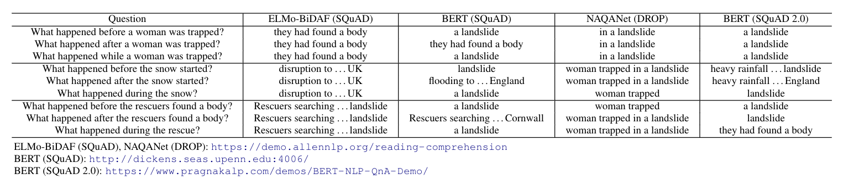
Text: Heavy snow is causing disruption to transport across the UK, with heavy rainfall bringing flooding to the south-west of England. Rescuers searching for a woman trapped in a landslide at her home said they had found a body.
SNOW
LANDSLIDE
TRAPPED
FOUND
SAID
TIME
PRESENT
Existing systems don’t really use “time” to answer these questions.
Notes:
This is an example. (read). This is the timeline for those highlighted events. When we ask questions about temporal orderings to existing MRC systems, we realize that they don't do well. One key problem is that they seem to ignore those key words that define temporal orderings, and thus generating almost the same answers no matter what. In other words, they don't really use "time" to answer these time questions.

Slide 56
Text: Heavy snow is causing disruption to transport across the UK, with heavy rainfall bringing flooding to the south-west of England. Rescuers searching for a woman trapped in a landslide at her home said they had found a body.
SNOW
LANDSLIDE
TRAPPED
FOUND
SAID
TIME
PRESENT
Existing systems don’t really use “time” to answer these questions.
Notes:
This phenomena is quite consistent across multiple systems trained on different datasets. The first step to fix this problem is to collect a dataset dedicated for time, which is the TORQUE dataset we're talking about today.

Slide 57
Text: Heavy snow is causing disruption to transport across the UK, with heavy rainfall bringing flooding to the south-west of England. Rescuers searching for a woman trapped in a landslide at her home said they had found a body.
SNOW
LANDSLIDE
TRAPPED
FOUND
SAID
TIME
PRESENT
Existing systems don’t really use “time” to answer these questions.
Q: What happened before the snow started?
A: landslide, said
Q: What happened after the snow started?
A: found
Q: What happened during the snow?
A: snow
GPT-4o; accessed in Jun 2024
Please choose from the following options: (a) snow, (b) a landslide, (c) rescuers said something, (d) rescuers found a body, (e) I don't know. You can choose multiple options if multiple answers apply.
Notes:
This phenomena is quite consistent across multiple systems trained on different datasets. The first step to fix this problem is to collect a dataset dedicated for time, which is the TORQUE dataset we're talking about today.

Slide 58
TORQUE^{[1]}: Data collection process
Given a passage, an annotator needs to
Label all the events
Repeat the following steps
  Ask a question querying temporal relations
  Select all the correct answers from the event list
  Slightly perturb the question and answer it
[1] TORQUE: A Reading Comprehension Dataset of Temporal Ordering Questions. Ning et al., EMNLP’20.
Notes:
The data collection process for TORQUE was as follows. (read). As you can see, these steps were designed to handle the aforementioned challenges correspondingly.

Slide 59
Perturbations of existing questions
A temporal relation can be represented as a triplet: (Event A, Relation r, Event B)
A valid question is: (?, r, B)
  What happened after B?
Perturbation: (?, r’, B)
  What happened before/while …?
  What had begun before B?
  What happened before B finished?
  …
Notes:
There’re two important concepts for TORQUE. First, what do we mean by a temporal relation question. A temporal relationship is a triplet of event A, relation r, and event B. There are many ways to ask temporal relation questions, and we choose those questions that are querying one of the events in TORQUE. By perturbation, we mean, keep the event in the original question, but slightly change the relation type. For instance, …

Slide 60
How to Answer These Questions
Must choose from the list of events
Must choose all the correct answers
Answer from the time point when the passage was written.
Notes:
The second important concept for understanding TORQUE is how to answer those questions. We have three guidelines here.

Slide 61
TORQUE
Heavy snow is causing disruption to transport across the UK, with heavy rainfall bringing flooding to the south-west of England. Rescuers searching for a woman trapped in a landslide at her home said they had found a body.
The loan may be extended by the McAlpine group for an additional year with an increase in the conversion price to $2.50 a share. The sale of shares to the McAlpine family along with the recent sale of 750,000 shares of Meridian stock to Haden MacLellan Holding PLC of Surrey, England and a recent public offering have increased Meridian's net worth to $8.5 million, said William Feniger, chief executive officer of Toledo, Ohio-based Meridian.
This time, however, some analysts think he could face a real battle. "Without some unexpected coup de theatre, I don't see what will block the Paribas bid," said Philippe de Cholet, analyst at the brokerage Cholet-Dupont amp Cie. Mr. de Cholet said Mr. Fournier's biggest hope was to somehow persuade regulatory authorities to block the bid.
Notes:
We took passages from English news articles. We recruited crowd workers from Amazon Mechanical Turk, and had them ask questions about temporal relations, and had them answer these questions as well.

Slide 62
TORQUE
3.2k passages from the 2.8k articles in TempEval3
Two sentences per passage
50 tokens per passage
Heavy snow is causing disruption to transport across the UK, with heavy rainfall bringing flooding to the south-west of England. Rescuers searching for a woman trapped in a landslide at her home said they had found a body.
The loan may be extended by the McAlpine group for an additional year with an increase in the conversion price to $2.50 a share. The sale of shares to the McAlpine family along with the recent sale of 750,000 shares of Meridian stock to Haden MacLellan Holding PLC of Surrey, England and a recent public offering have increased Meridian's net worth to $8.5 million, said William Feniger, chief executive officer of Toledo, Ohio-based Meridian.
This time, however, some analysts think he could face a real battle. "Without some unexpected coup de theatre, I don't see what will block the Paribas bid," said Philippe de Cholet, analyst at the brokerage Cholet-Dupont amp Cie. Mr. de Cholet said Mr. Fournier's biggest hope was to somehow persuade regulatory authorities to block the bid.
Notes:
Specifically,

Slide 63
TORQUE
3.2k passages from the 2.8k articles in TempEval3
Two sentences per passage
50 tokens per passage
Heavy snow is causing disruption to transport across the UK, with heavy rainfall bringing flooding to the south-west of England. Rescuers searching for a woman trapped in a landslide at her home said they had found a body.
The loan may be extended by the McAlpine group for an additional year with an increase in the conversion price to $2.50 a share. The sale of shares to the McAlpine family along with the recent sale of 750,000 shares of Meridian stock to Haden MacLellan Holding PLC of Surrey, England and a recent public offering have increased Meridian's net worth to $8.5 million, said William Feniger, chief executive officer of Toledo, Ohio-based Meridian.
This time, however, some analysts think he could face a real battle. "Without some unexpected coup de theatre, I don't see what will block the Paribas bid," said Philippe de Cholet, analyst at the brokerage Cholet-Dupont amp Cie. Mr. de Cholet said Mr. Fournier's biggest hope was to somehow persuade regulatory authorities to block the bid.

Slide 64
TORQUE
3.2k passages from the 2.8k articles in TempEval3
Two sentences per passage
50 tokens per passage
24.9k events
Heavy snow is causing disruption to transport across the UK, with heavy rainfall bringing flooding to the south-west of England. Rescuers searching for a woman trapped in a landslide at her home said they had found a body.
The loan may be extended by the McAlpine group for an additional year with an increase in the conversion price to $2.50 a share. The sale of shares to the McAlpine family along with the recent sale of 750,000 shares of Meridian stock to Haden MacLellan Holding PLC of Surrey, England and a recent public offering have increased Meridian's net worth to $8.5 million, said William Feniger, chief executive officer of Toledo, Ohio-based Meridian.
This time, however, some analysts think he could face a real battle. "Without some unexpected coup de theatre, I don't see what will block the Paribas bid," said Philippe de Cholet, analyst at the brokerage Cholet-Dupont amp Cie. Mr. de Cholet said Mr. Fournier's biggest hope was to somehow persuade regulatory authorities to block the bid.

Slide 65
TORQUE
3.2k passages from the 2.8k articles in TempEval3
Two sentences per passage
50 tokens per passage
24.9k events
Heavy snow is causing disruption to transport across the UK, with heavy rainfall bringing flooding to the south-west of England. Rescuers searching for a woman trapped in a landslide at her home said they had found a body.
Q1: What event has already finished?
Q2: What event has begun but has not finished?
Q3: What will happen in the future?
For each passage, we have
- 3 hard-coded questions
Hard-coded questions
Q4: What happened before a woman was trapped?
Q5: What had started before a woman was trapped?
Q6: What happened while a woman was trapped?
Q7: What happened after a woman was trapped?
- on average, 7 user-generated questions
Q8: What happened at about the same time as the snow?
Q9: What happened after the snow started?
Q10: What happened before the snow started?
User-provided

Slide 66
TORQUE
3.2k passages from the 2.8k articles in TempEval3
Two sentences per passage
50 tokens per passage
24.9k events
Heavy snow is causing disruption to transport across the UK, with heavy rainfall bringing flooding to the south-west of England. Rescuers searching for a woman trapped in a landslide at her home said they had found a body.
Q1: What event has already finished?
Q2: What event has begun but has not finished?
Q3: What will happen in the future?
For each passage, we have
- 3 hard-coded questions
Hard-coded questions
Q4: What happened before a woman was trapped?
Q5: What had started before a woman was trapped?
Q6: What happened while a woman was trapped?
Q7: What happened after a woman was trapped?
- on average, 7 user-generated questions
Group of contrast questions
- Grouped as contrast sets
Q8: What happened at about the same time as the snow?
Q9: What happened after the snow started?
Q10: What happened before the snow started?
Group of contrast questions

Slide 67
TORQUE
3.2k passages from the 2.8k articles in TempEval3
Two sentences per passage
50 tokens per passage
24.9k events
Heavy snow is causing disruption to transport across the UK, with heavy rainfall bringing flooding to the south-west of England. Rescuers searching for a woman trapped in a landslide at her home said they had found a body.
Q1: What event has already finished?
A: searching trapped landslide said found
Q2: What event has begun but has not finished?
A: snow causing disruption rainfall bringing flooding
Q3: What will happen in the future?
A: No answers.
For each passage, we have
- 3 hard-coded questions
Hard-coded questions
Q4: What happened before a woman was trapped?
A: landslide
Q5: What had started before a woman was trapped?
A: snow rainfall landslide
Q6: What happened while a woman was trapped?
A: searching
Q7: What happened after a woman was trapped?
A: searching said found
- on average, 7 user-generated questions
Group of contrast questions
- Grouped as contrast sets
Q8: What happened at about the same time as the snow?
A: rainfall
Q9: What happened after the snow started?
A: causing disruption bringing flooding searching trapped landslide said found
Q10: What happened before the snow started?
A: No answers.
Group of contrast questions
Notes:
6'30''

Slide 68
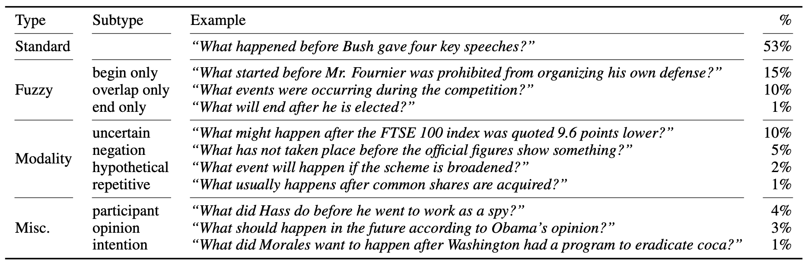
Temporal phenomena in TORQUE
By manually checking a sample of 200 questions, we have the following categorization on their temporal phenomena (some questions can have multiple types):

Slide 69
Experiment
Setup:
  Given a passage and a question,
  model looks at every token in the passage
  makes a binary classification of whether this token is an answer to the question or not
Model:
  One-layered perceptron on top of RoBERTa
Split:
  Train 80%, dev 5%, test 15%
  Dev & test are provided by 5 different annotators on their events; by 3 different annotators on their answers
Notes:
We did some baseline experiments on TORQUE. The setup was as follows.
40''

Slide 70
Experiment
Human F1
Human EM
Human C
F1 & EM: standard metrics when there’re multiple reference answers
C (consistency) is the percentage of contrast groups for which a model’s predictions have F1>=80% for all questions in a group
Original talk in 2020: https://slideslive.com/38938807
Notes:
This is the system performance as compared to human performance. First, we can see as we increased the training set from 50% to 100%, system performance didn’t improve much, which means the key problem is not lack of data anymore and we should study better modeling techniques now. We used three metrics, F1, EM, and consistency. F1 and EM are … Consistency is …. Since the three metrics are getting more and more strict, we can see both human performance and system performance are also lower and lower as we change metrics, but human performance is much more robust and only dropped a few points when switching from EM to consistency. Overall, RoBERTa is behind human performance by a large margin.
(1'11'')

Slide 71
A (very biased) view of advancement in ”time”
TimeBank

Slide 72
A (very biased) view of advancement in ”time”
(E,T)
EventTime
AbsoluteTimeline
TimeBank

Slide 73
A (very biased) view of advancement in ”time”
(E,T)
EventTime
AbsoluteTimeline
Spatiotemporal grounding
SteQE
TimeBank

Slide 74
A (very biased) view of advancement in ”time”
(E,T)
EventTime
AbsoluteTimeline
Spatiotemporal grounding
SteQE
TimeBank
(E,E)
TimeBank-Dense

Slide 75
A (very biased) view of advancement in ”time”
(E,T)
EventTime
AbsoluteTimeline
Spatiotemporal grounding
SteQE
TimeBank
(E,E)
Multi-axis
MATRES
TimeBank-Dense

Slide 76
A (very biased) view of advancement in ”time”
(E,T)
EventTime
AbsoluteTimeline
Spatiotemporal grounding
SteQE
TimeBank
Formalism
(E,E)
Natural language
Multi-axis
MATRES
QA format
TORQUE
TimeBank-Dense

Slide 77
Time is a good vehicle to study reasoning
monitor
0.6
0.7
0.4
0.3
cascaded
0.8
ordered
0.2
Reasoning constraint: time cannot be a loop

Slide 78
Global inference (a toy example)
Option 1
Option 2
Option 3
monitor
monitor
monitor
0.6
0.7
0.4
0.7
0.6
0.3
cascaded
ordered
cascaded
ordered
cascaded
ordered
0.2
0.8
0.8
0.6+0.2+0.7=1.5
0.4+0.8+0.7=1.9
0.6+0.3+0.8=1.7
We should not only select the assignment with the best score, but also avoid loops

Slide 79
Global inference (a toy example)
Option 2
monitor
monitor
monitor
0.6
0.7
0.4
0.7
0.6
0.3
cascaded
ordered
cascaded
ordered
cascaded
ordered
0.2
0.8
0.8
0.6+0.2+0.7=1.5
0.4+0.8+0.7=1.9
0.6+0.3+0.8=1.7
We should not only select the assignment with the best score, but also avoid loops

Slide 80
Global inference (a toy example)
Option 2
monitor
monitor
monitor
0.6
0.7
0.4
0.7
0.6
0.3
cascaded
ordered
cascaded
ordered
cascaded
ordered
0.2
0.8
0.8
0.6+0.2+0.7=1.5
0.4+0.8+0.7=1.9
0.6+0.3+0.8=1.7
How should we formulate this procedure?
Global inference via ILP
[Roth & Yih, 2004]

Slide 81
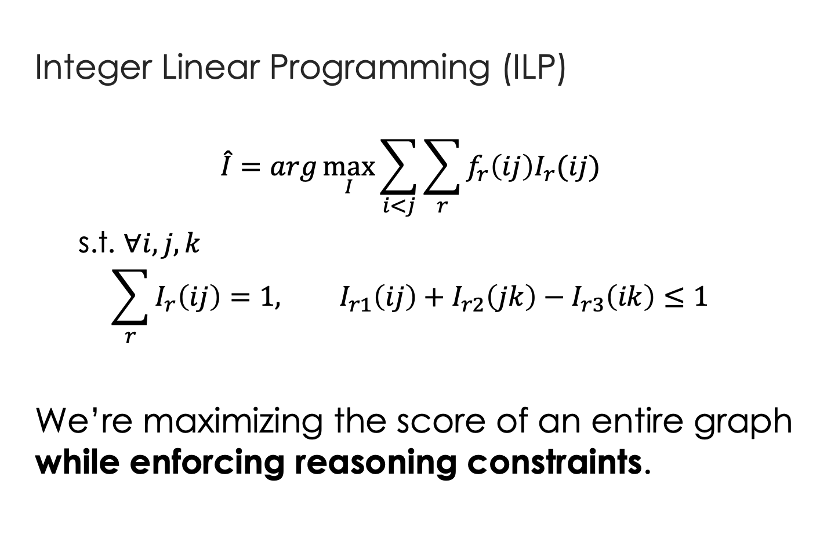




Global inference via ILP
$$I_{→}\left(ij\right)=1$$
$$f_{→}\left(ij\right)=0.6$$
Event i
j
$$f_{←}\left(ij\right)=0.4$$
Integer Linear Programming (ILP)
  $$\hat{I}=arg\max_{I}{\sum_{i<j}{\sum_{r}{f_{r}\left(ij\right)I_{r}(ij)}}}$$
  s.t. $∀i,j,k$
  $$\sum_{r}{I_{r}\left(ij\right)}=1, I_{r1}\left(ij\right)+I_{r2}\left(jk\right)−I_{r3}\left(ik\right)≤1$$
We’re maximizing the score of an entire graph while enforcing reasoning constraints.
$$I_{←}\left(ij\right)=1$$
real variable
boolean variable
Uniqueness
Reasoning constraints

Slide 82
Benefit of global inference via ILP
5%
Global inference via ILP
Baseline
[UTTime] Laokulrat et al. *SEM’13. UTTime: Temporal relation classiﬁcation using deep syntactic features.
[Perceptron+ILP] Do et al. EMNLP’12. Joint inference for event timeline construction.

Slide 83
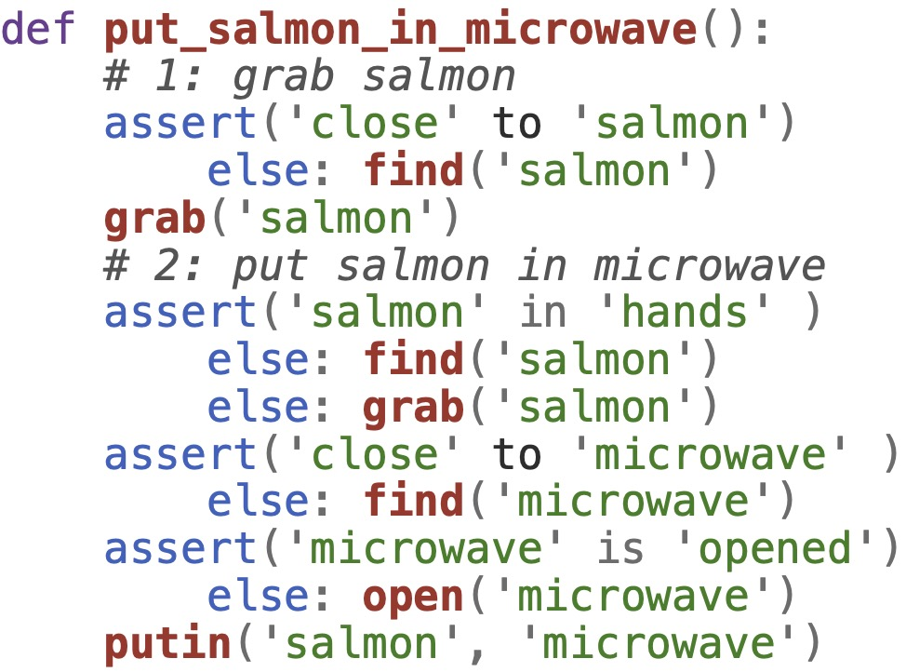

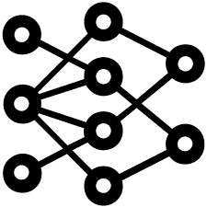
(Naïve) Robot motion planning
I spilled my Coke, can you bring me something to clean it up?
Find the sponge
Pick up the sponge
Go to the table
Bring the sponge to the user
…
[3] Singh et al. ProgPrompt: Generating situated robot task plans using large language models, ICRA 2023.
LLM
Action executability feedback (2)
LLMs provide common knowledge
Extra action module
LLMs as task planners
[1] Huang et al. Language Models as Zero-Shot Planners, ICML 2022.
[2] Ahn et al. Do as I can, not as I say: Grounding language in robotic affordances. CoRL 2022.
Notes:
LLM is a super large machine learning model trained on a large quantity of text data. The goal of LLMs is to mimic the way humans are speaking or writing.
Since it tries to simulate human speaking style, it inherently encodes many common knowledge in human’s society.

Slide 84
Robot motion planning via “Temporal Logic”
Temporal Logic is a rigorous system of rules for requirement engineering that can capture many complex spatial, temporal, and logical requirements.
If we can translate natural language task descriptions into temporal logic, then robots will know what to do and when to do it, not how to do it.

Slide 85
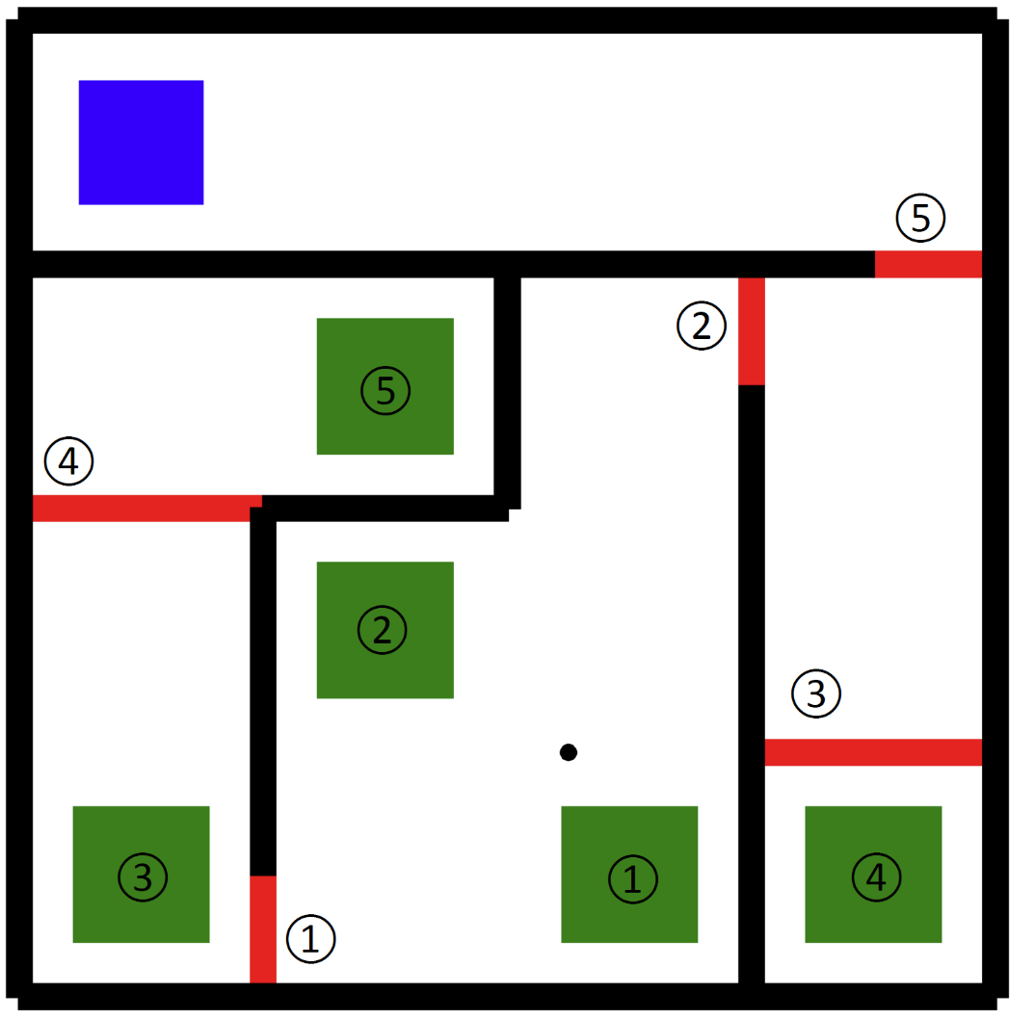



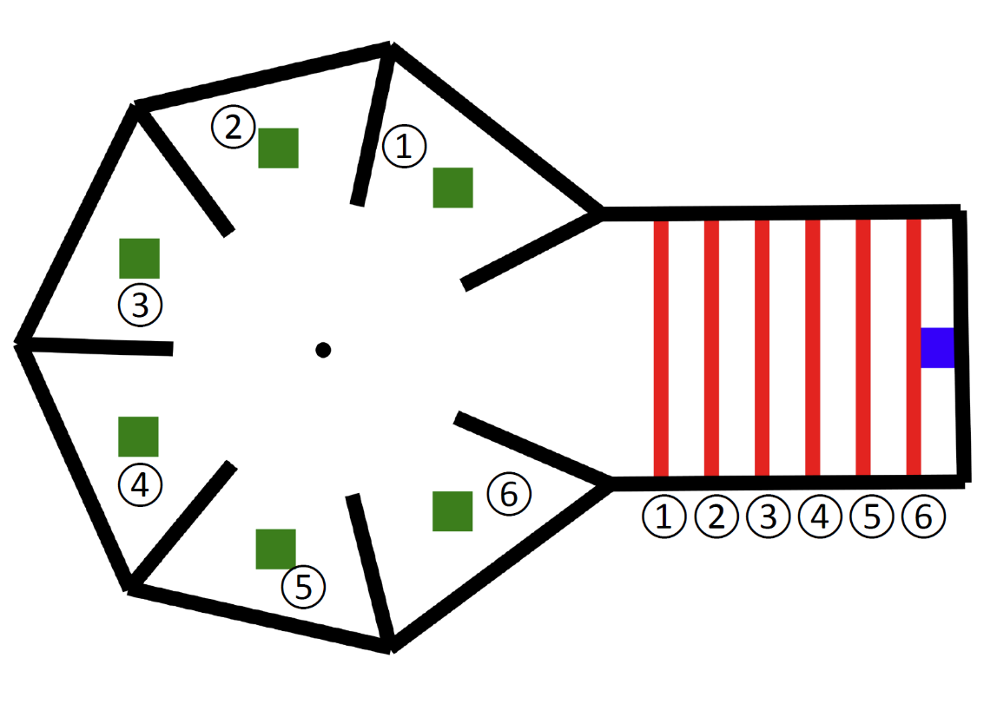
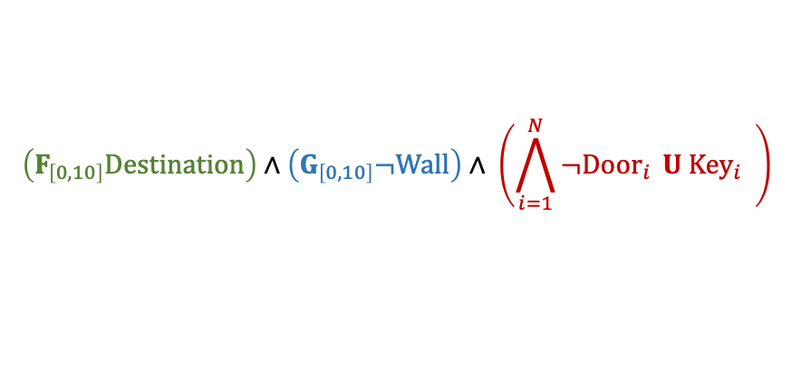
A simple example of temporal logic
Robot puzzle-solving
Robots are asked to visit the blue goal region
Robots should always reach their destinations with minimum traveling time, regardless of the puzzle type
Robots cannot travel through walls (black) or closed doors (red)
Robots must visit the correspondingly numbered green region to pick the keys to open the doors
Temporal logic representation of these rules is:
$$\left(F_{\left[0,10\right]}Destination\right)∧\left(G_{\left[0,10\right]}¬Wall\right)∧ \left(\bigwedge_{i=1}^{N}{¬Door_{i}} U {Key}_{i} \right)$$

Slide 86
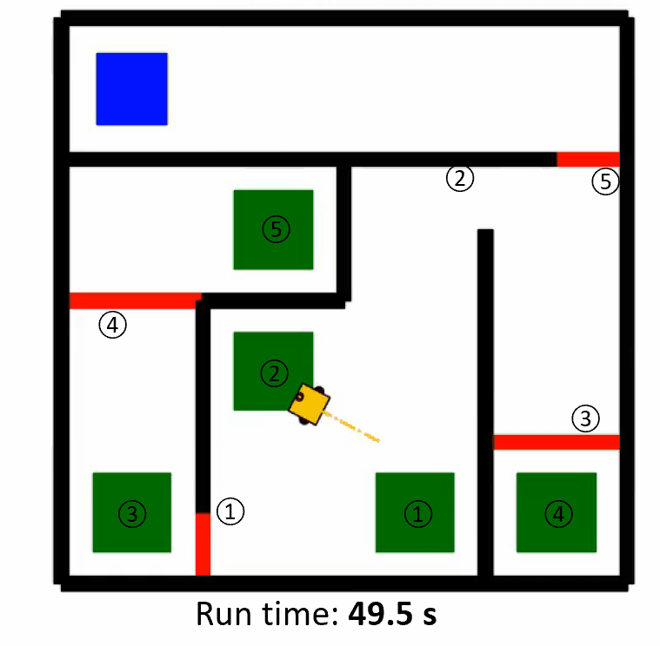
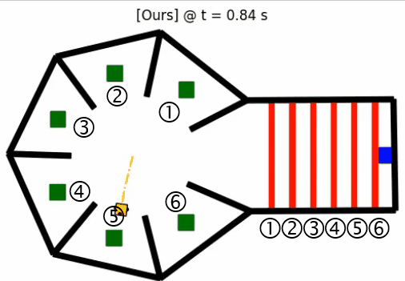
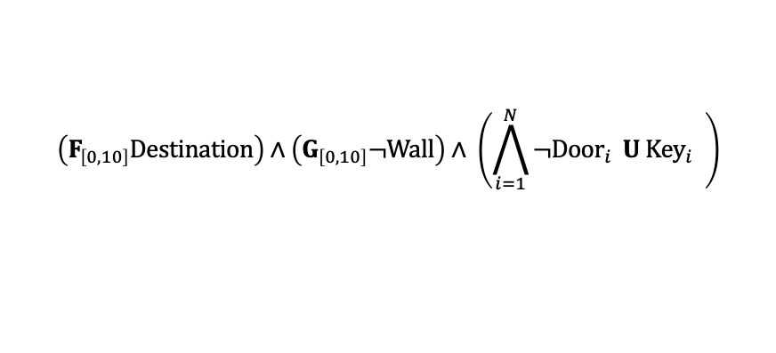
Robot task and motion planning from temporal logic
Planning algorithms can plan motions for agents with provably optimal computational complexity based on temporal logic representation^{[1]}
$$\left(F_{\left[0,10\right]}Destination\right)∧\left(G_{\left[0,10\right]}¬Wall\right)∧ \left(\bigwedge_{i=1}^{N}{¬Door_{i}} U {Key}_{i} \right)$$
[1] Sun, Dawei, Jingkai Chen, Sayan Mitra, and Chuchu Fan. “Multi-agent motion planning from signal temporal logic specifications.” IEEE Robotics and Automation Letters (2022).

Slide 87
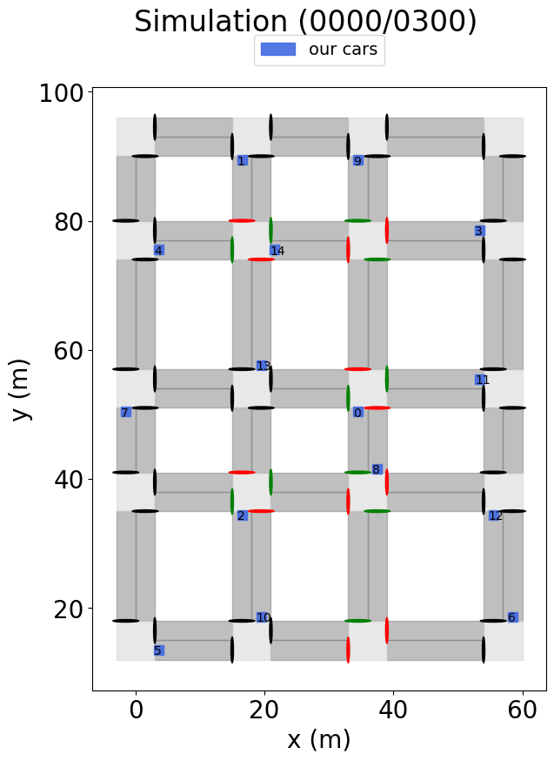
Robot task and motion planning from temporal logic
Embed the following rules in one vehicle’s action, trained in a single intersection^{[1]}
  Avoid rear-end collision
  Stop sign rules
  Traffic light rules
[1] Meng, Yue, and Chuchu Fan. “Signal Temporal Logic Neural Predictive Control.” IEEE Robotics and Automation Letters (2023).

Slide 88
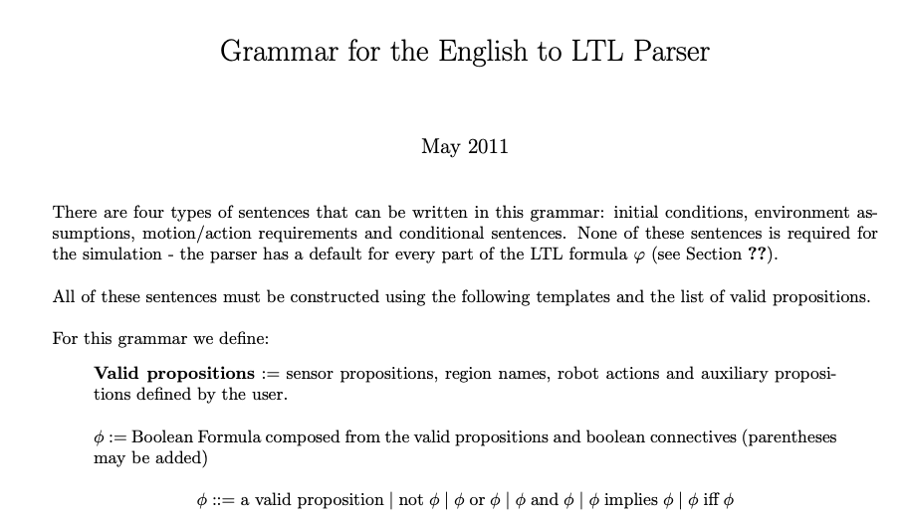
Natural language to temporal logic (NL2TL)
Previous works usually used hard-code parsing rules and made strong assumptions on input/output format.

Slide 89
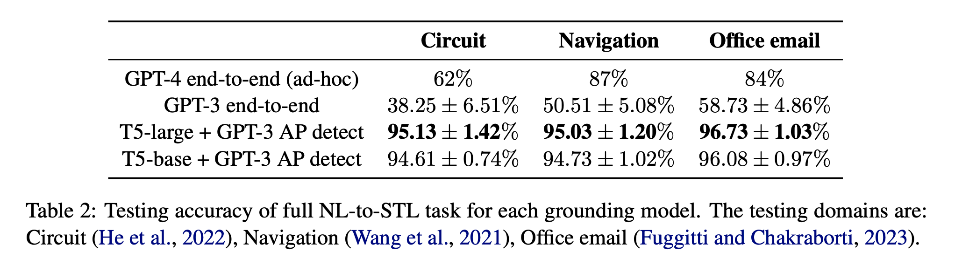
Natural language to temporal logic (NL2TL)^{[1]}
[1] NL2TL: Transforming Natural Languages to Temporal Logics using Large Language Models. Chen et al., EMNLP’23.

Slide 90

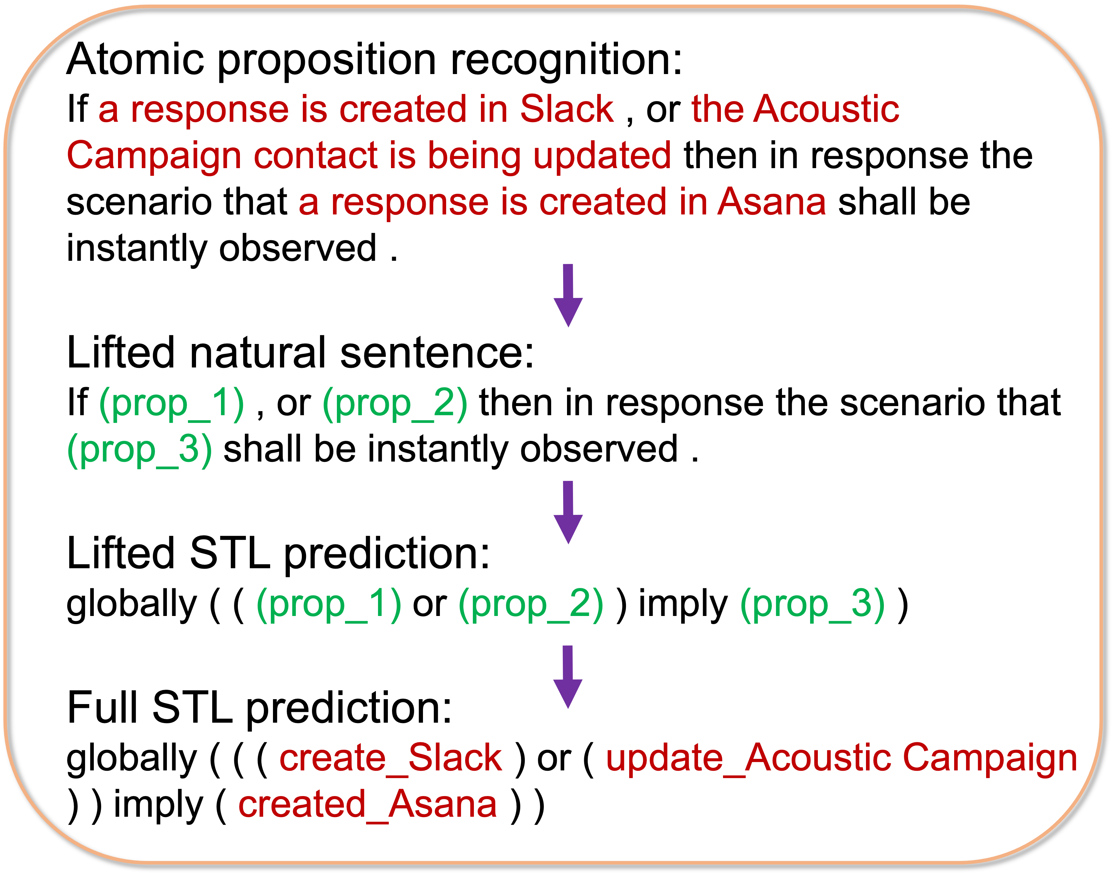
Natural language to temporal logic (NL2TL)^{[1]}
LLM-enhanced dataset (30k NL-TL pairs)
Natural language input
T5 Text-to-Text Transfer Transformer
Temporal Logic output
The translation problem is split into two steps^{[1]}
Identify specific basic operating units (atomic propositions or APs) and hide them from translation.
Translate the Temporal Logic structure with hidden APs (lifted version) independent of application domains.
[1] NL2TL: Transforming Natural Languages to Temporal Logics using Large Language Models. Chen et al., EMNLP’23.

Slide 91


LLM-assisted data generation
LLM-enhanced dataset (30k NL-TL pairs)
Generator
Refined STL
Randomly generate using STL syntax rules
Human final check
Natural language input
T5 Text-to-Text Transfer Transformer
Temporal Logic output
STL-1
STL-2
TL2NL translation
TL2NL translation
Output NL-TL pairs
NL-1
NL-2
Remove “weird”(judged by LLMs) expressions
30k NL-TL pairs, across 5 different application domains (Circuit design, navigation, manipulation, household, email)
14k pairs collected from existing datasets.
16k pairs synthesized via GPT-3 and re-annotated.
# Operators per STL |  | # Words per sentence (no APs)
Median | Max | Median | Max
3 | 7 | 16 | 72
[1] NL2TL: Transforming Natural Languages to Temporal Logics using Large Language Models. Chen et al., EMNLP’23.

Slide 92
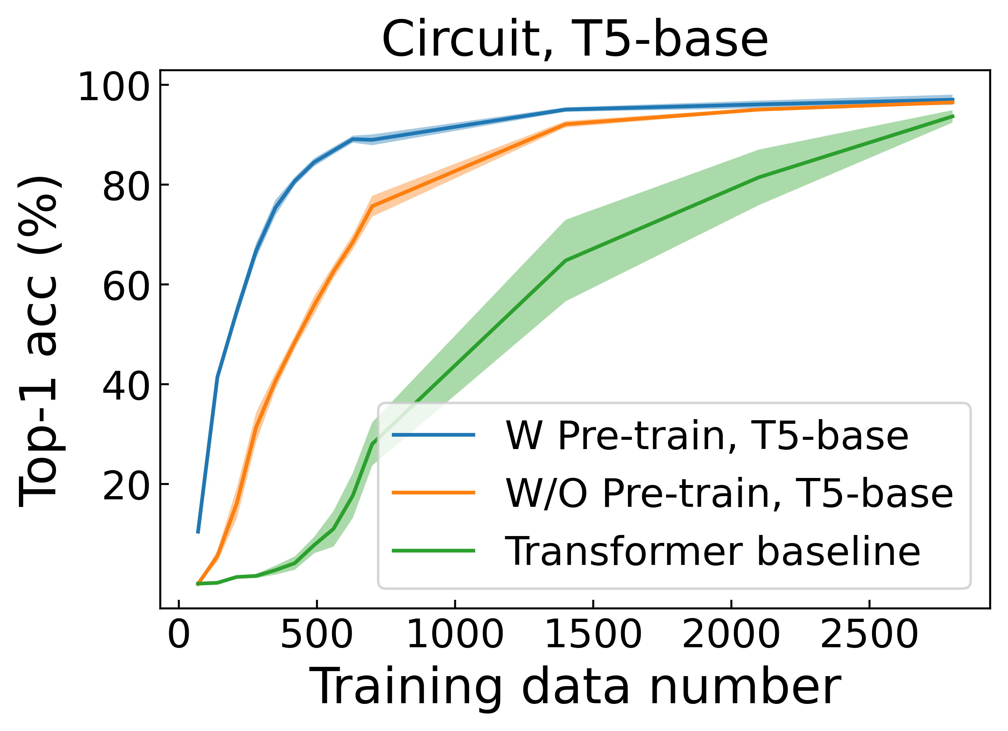
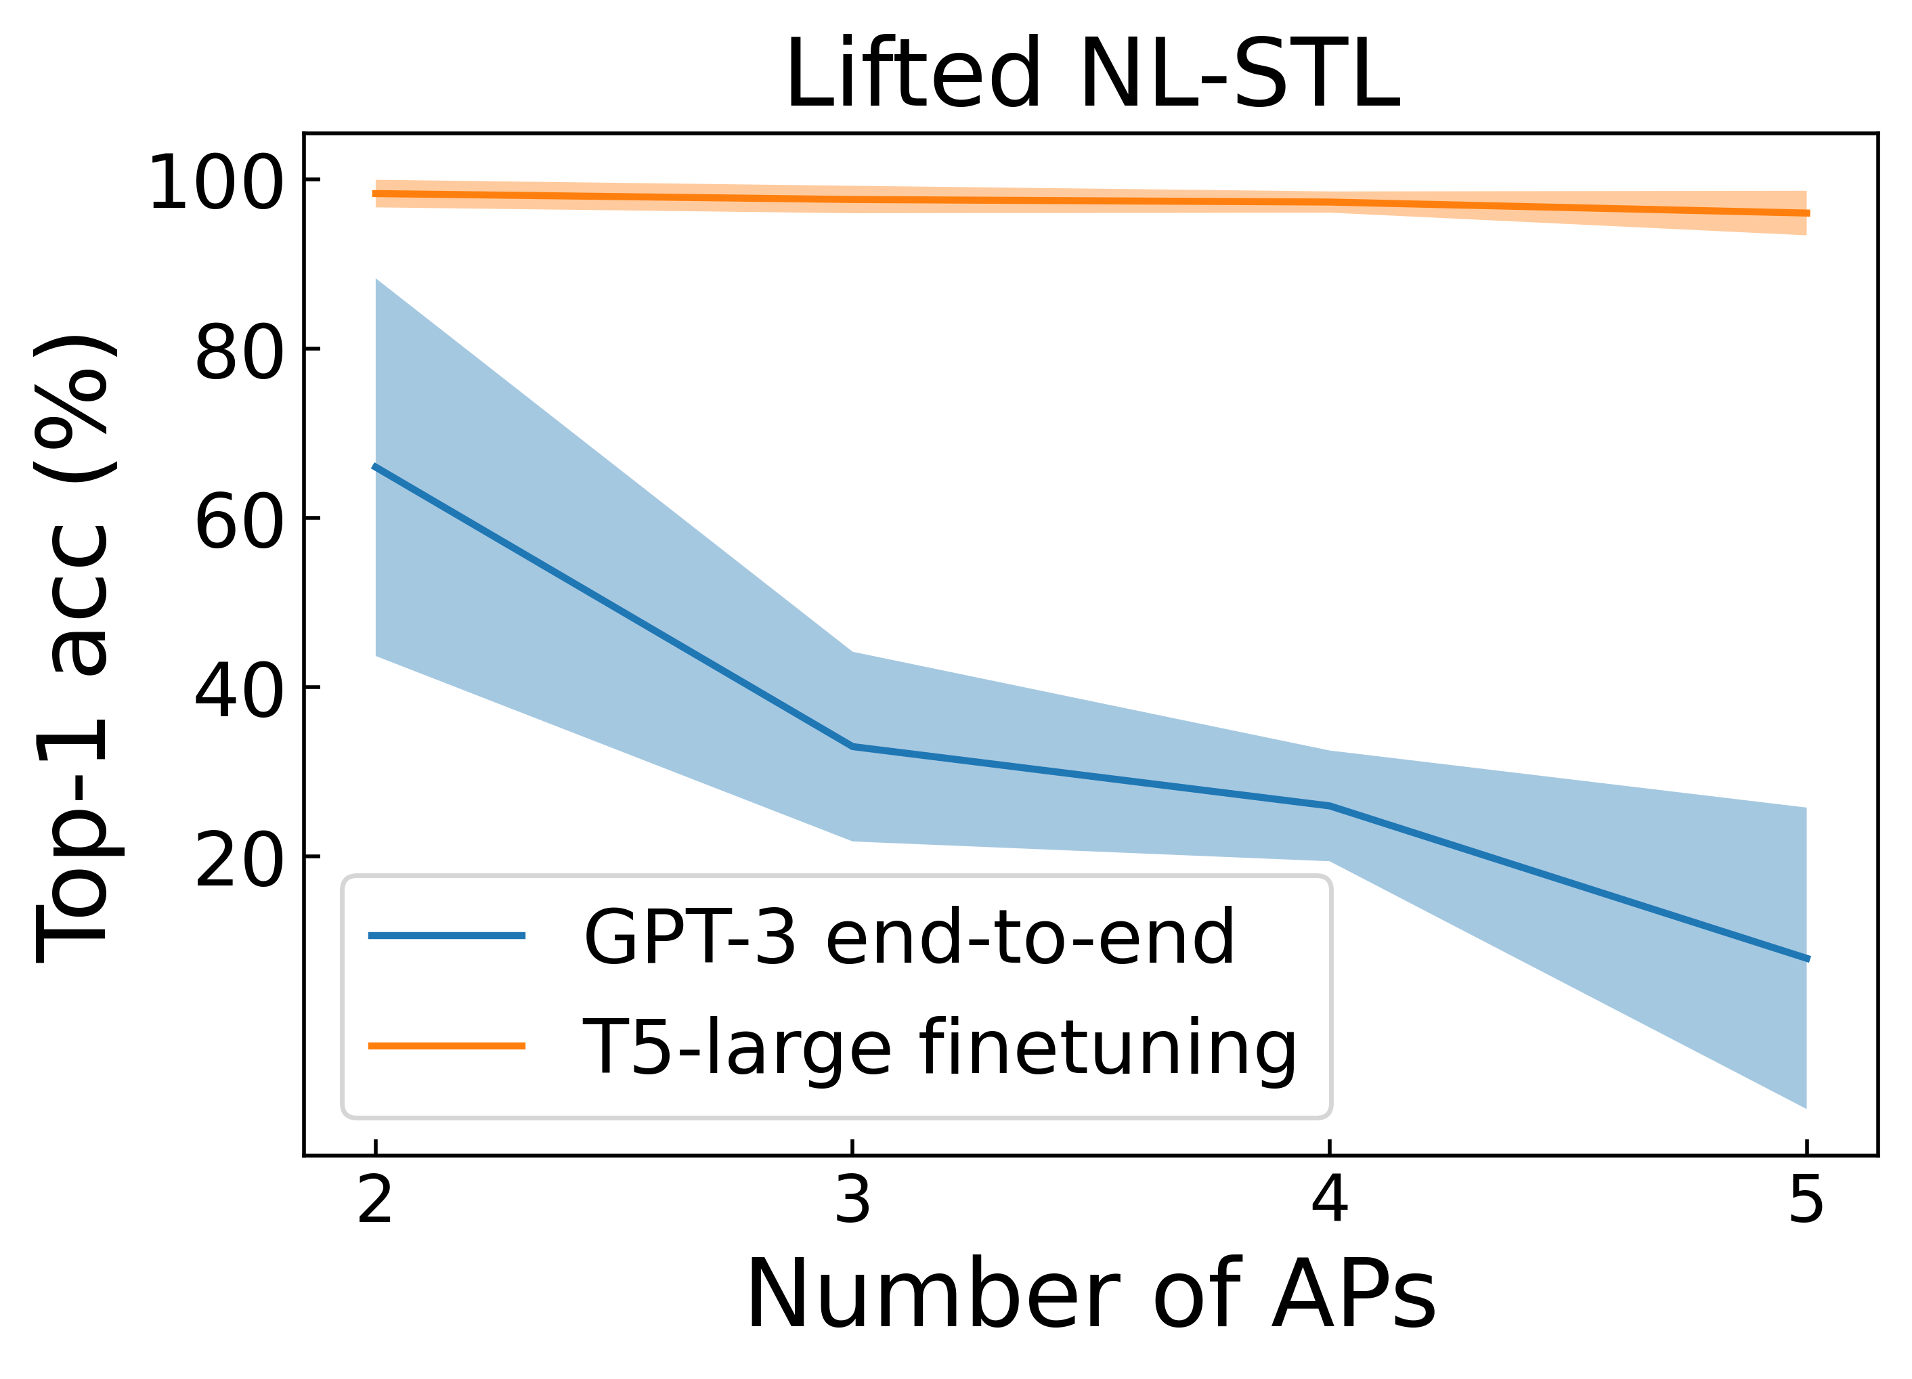
Translate English instructions to Temporal Logic specifications
Model | #parameters | Accuracy (%)
GPT-3 | 175B | 38.25-58.73
GPT-4 | n/a | 73
NL2TL^{[1]} | 770M | 95.03-96.73
NL2TL^{[1]} | 220M | 94.73-96.08
LLM-enhanced dataset (30k NL-TL pairs)
Natural language input
T5 Text-to-Text Transfer Transformer
Temporal Logic output
Pretrained model needs half the data to be fine-tuned within a previously unseen domain
End-to-end GPT-3’s performance gets worse as the #AP increases
[1] NL2TL: Transforming Natural Languages to Temporal Logics using Large Language Models. Chen et al., EMNLP’23.

Slide 93
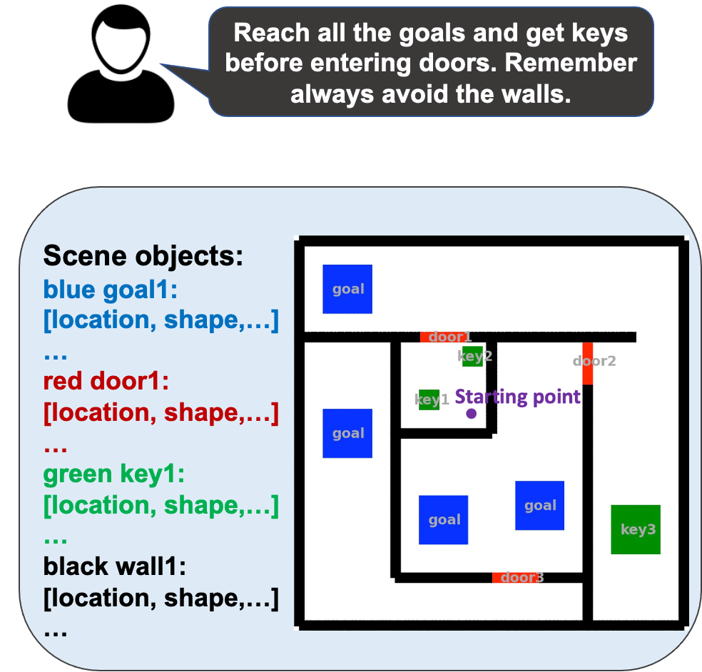


Auto-regressive LLM-based Task and Motion Planning (AutoTAMP)
Natural language feedback and clarification
Temporal Logic task specification
Language instruction
$$\text{finally}\text{(}\text{goal}\text{1 }\text{and} \text{goal}\text{2…) }\text{and}\text{ (}\text{negation} \text{door}\text{1 }\text{until} \text{key}\text{1…) }\text{and} \text{globally} \text{negation} \text{wall}$$
State observation
Real time input
Auto-regressive re-prompt
Algo. based syntactic checker/LLM iteration
Semantic checker:
LLM auto-iteration
Formal planner
(currently a TL-based TAMP planner)
State-time sequence
Intermediate Plan
Converged!
Final Plan
LLM-As-Translator & Checker
[1] AutoTAMP: Autoregressive task and motion planning with LLMs as translators and checkers. Chen et al., ICRA’24.

Slide 94
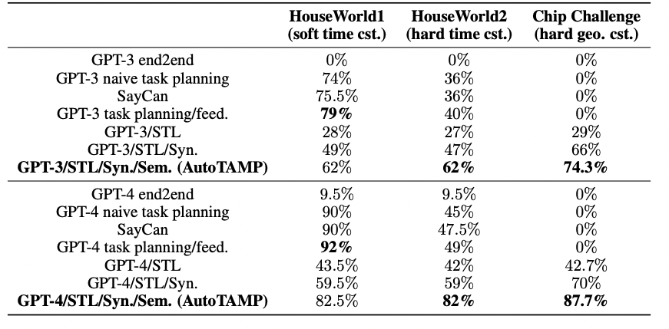
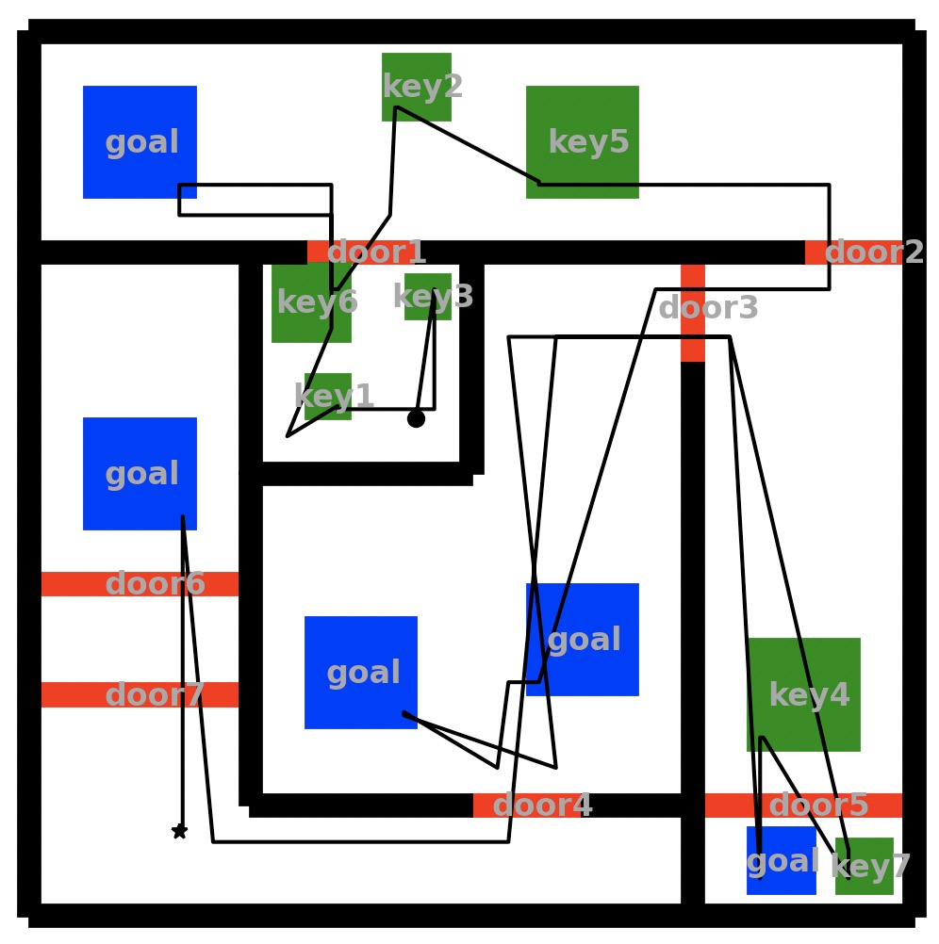
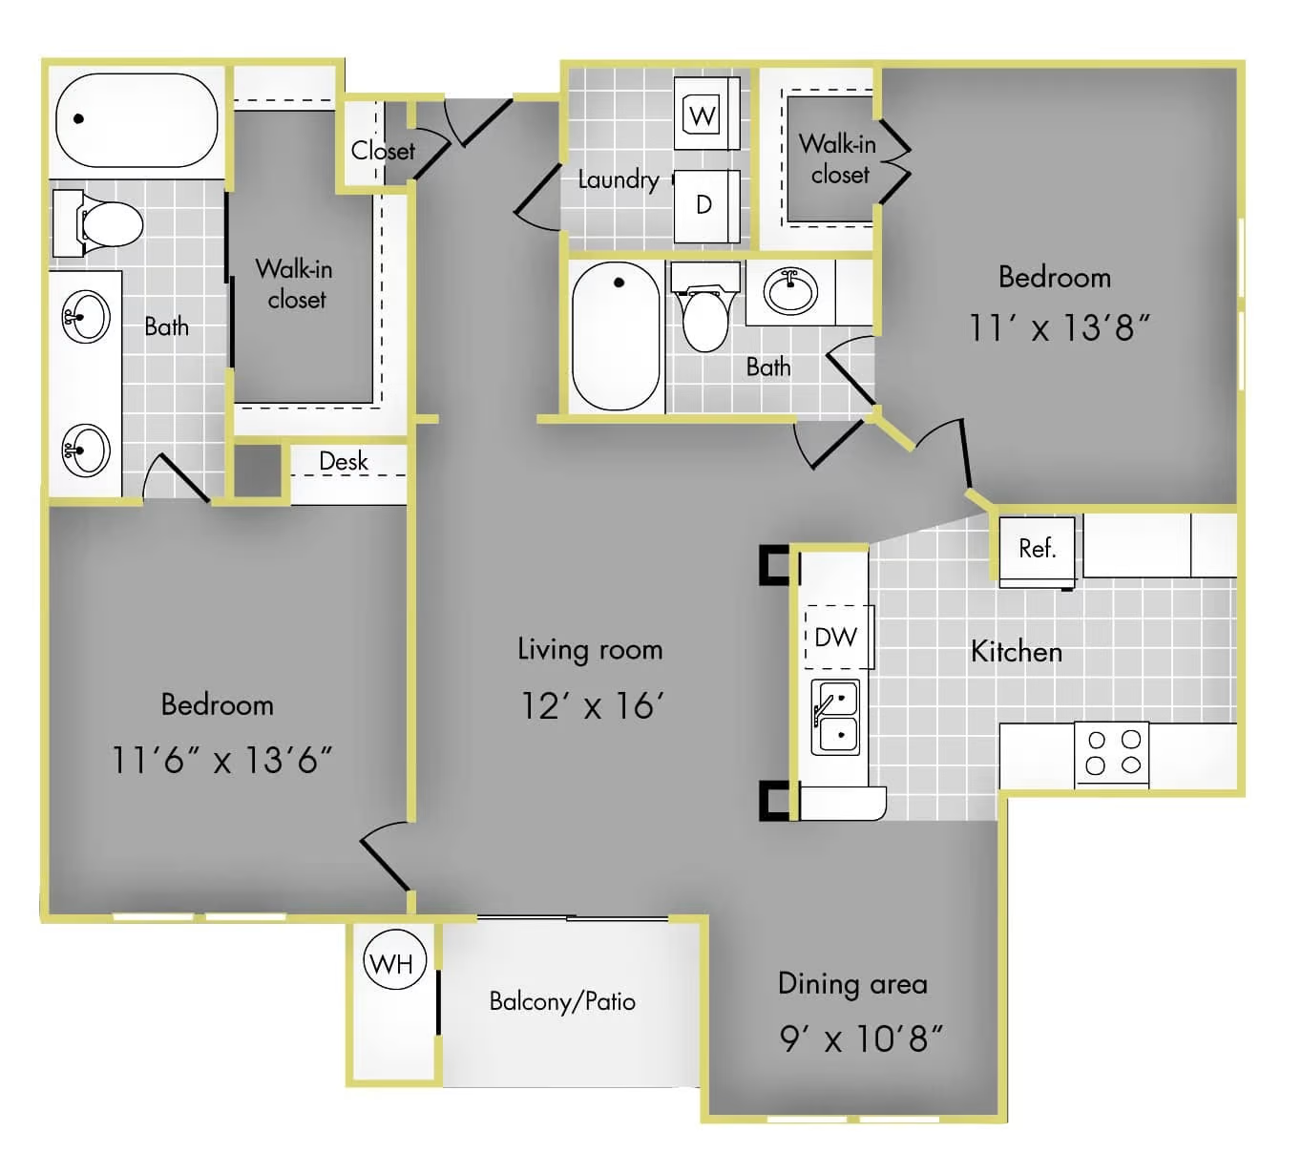
AutoTAMP results: Single-agent, time & geometric constraints
Solving puzzles
“Try to reach all the goals but you have to reach the corresponding key first to open the specific door. For example, you have to reach key1 ahead to open door1. Also, remember always do not touch the walls.”
Task success rates of different approaches in single-agent TAMP (results obtained in May 2023).
Household work
“Navigate into the pink bedroom and then go to the yellow restroom, but remember do not touch the livingroom at anytime.”
AutoTAMP uses TL as the intermediate language, which enables auto-regressive reasoning and significantly improves the success rate of using LLM for TAMP when there are hard timing and geometric constraints.
[1] AutoTAMP: Autoregressive task and motion planning with LLMs as translators and checkers. Chen et al., ICRA’24.

Slide 95
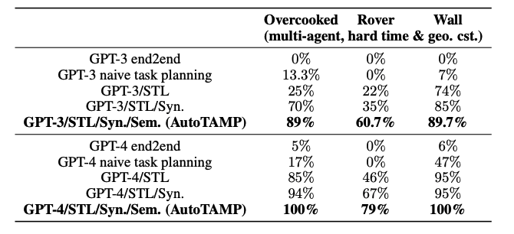

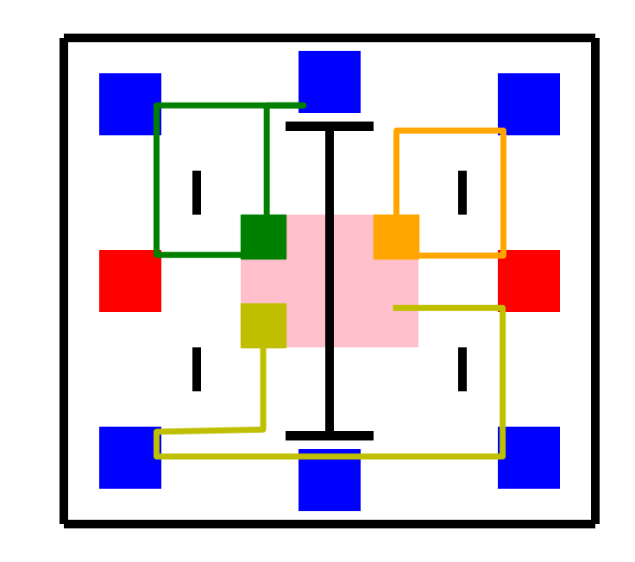
AutoTAMP results: Multi-agent, time & geometric constraints
Overcooked game
“Enter all the ingredient room to pick up food. Once entered ingredient rooms, go to cooking room within 3 seconds. And all the agents should not collide each other and black obstacles.”
Multi-agent surveillance
“All rovers must reach the pink charging station within 5 units of time each time they exit it. Once they reach their (blue) destination, they need to get to a red transmitter within 2-time units to send the collected information to the remote control. Rovers must keep clear of black walls and other rovers. All target areas need to be visited.”
Task success rates of different approaches in multi-agent TAMP (results obtained in May 2023).
Replacing the TAMP planner with an any planner, this framework will interactively provide rigorous and explainable assistants for human operators, with improved success rates even with unstructured human user inputs.
[1] AutoTAMP: Autoregressive task and motion planning with LLMs as translators and checkers. Chen et al., ICRA’24.

Slide 96
Recap: structured view of “temporal” work
 | Information extraction | Question Answering | Reasoning
Intrinsic to “time” (i.e., targeting a better understanding of time) | Time expressions Temporal relations Temporal grounding | Temporal order QA | Temporal relation graph inference Temporal logic
Extrinsic to “time” (i.e., solving tasks that require consideration of time) | Timeline summarization Temporal knowledge graphs Causality | Situated QA Time-sensitive QA Temporal QA over knowledge graphs | Robotic control

Slide 97
Recap: main papers covered in this talk
 | Information extraction | Question Answering | Reasoning
Intrinsic to “time” (i.e., targeting a better understanding of time) | SteQE^{[1]} | TORQUE^{[2]} | NL2TL^{[3]}
Extrinsic to “time” (i.e., solving tasks that require consideration of time) | Timeline summarization Temporal knowledge graphs Causality | Situated QA Time-sensitive QA Temporal QA over knowledge graphs | AutoTEMP^{[4]}
[1] A Meta-framework for Spatiotemporal Quantity Extraction from Text. Ning et al., ACL’22.
[2] TORQUE: A Reading Comprehension Dataset of Temporal Ordering Questions. Ning et al., EMNLP’20.
[3] NL2TL: Transforming Natural Languages to Temporal Logics using Large Language Models. Chen et al., EMNLP’23.
[4] AutoTAMP: Autoregressive task and motion planning with LLMs as translators and checkers. Chen et al., ICRA’24.

Slide 98
Summary
We only focused on tasks that are intrinsic to time. Many existing works where “time” is supporting the main tasks are skipped.
  SteQE exemplifies “what could happen if we move closer to the extreme of formalism”
  TORQUE shows “what could happen if we use natural language to annotate natural language”
“Time” is a good vehicle to study reasoning. LLM still struggles but can improve
  Once we teach formalism to it (ILP, temporal logic, etc.)
  Then we adopt solvers, tools, APIs to perform reasoning

